Slide 1
Electronic Supporting Materials on the Microchimica Acta Publication Entitled
An impedimetric biosensor for E. coli O157:H7 based on the use of self-assembled gold nanoparticles and protein G
Donghai Lin1,a, Rajesh G. Pillai2, William Edward Lee3,b and Abebaw B. Jemere2*
1Department of Chemistry, University of Alberta, Edmonton, AB, Canada T6G 2G2
2National Research Council Canada – Nanotechnology Research Centre†, Edmonton, AB, Canada T6G 2M9
3Defence Research and Development Canada – Suffield Research Centre, Medicine Hat, AB, Canada T1A 8K6
*Corresponding author: E-mail: abebaw.jemere@nrc-cnrc.gc.ca
Current addresses: aSchool of Food Science and Engineering, Foshan University, Foshan, China; bPlatinum Research and Technologies, Medicine Hat, Alberta, platinum@telusplanet.net
†Formerly known as National Institute for Nanotechnology

Slide 2
Supplementary Table 1. Evaluation of parameters using Randles equivalent circuit model for Au electrode.
Electrode surface | R_{s} (Ω) | R_{ct} (Ω) | C_{dl} (µF)
Au | 141 | 174 | 7.9
Au/PrG-thiol | 142 | 3500 | 032
Au/1,6-HDT/AuNP | 149 | 230 | 7.3
Au/1,6-HDT/AuNP/PrG-thiol | 145 | 2100 | 0.28
Au/1,6-HDT/AuNP/PrG-thiol/IgG | 144 | 2300 | 0.22

Slide 3
Supplementary Figure S1. (A) Cyclic voltammograms of planar gold electrodes following modification with 500 μg ml⁻¹ PrG-thiol incubated for different length of times at a scan rate of 100 mV s⁻¹ in 1 mM K₄[Fe(CN)₆/K₃[Fe(CN)₆] containing 0.1 M KNO₃ supporting electrolyte using Ag/AgCl as reference electrode and Pt wire as counter electrode. (B) Nyquist plots were obtained at frequencies of 0.1 Hz to 10⁵ Hz.

Slide 4
Supplementary Figure S2. Cyclic voltammograms of PrG-thiol modified Au electrode at a scan rate of 100 mV s⁻¹. All other experimental conditions are as in Fig. 1a. Total charge was determined by the area under the redox peak at ~0.94 V.

Slide 5
Supplementary Figure S3. Nyquist plots of planar gold electrodes obtained at frequencies of 0.1 Hz to 10⁵ Hz following modification of PrG-thiol modified electrode with varying amounts of IgG for a fixed 2 h.

Slide 6
Supplementary Fig. S4. (A) Cyclic voltammograms of bare Au electrode (black curve), PrG-thiol modified Au electrode (Au/PrG; red curve), IgG immobilized electrode (Au/PrG/Ab; blue curve) and after incubation of the sensor with HKEC (green curve) at a scan rate of 100 mV s⁻¹ in 1 mM K₄[Fe(CN)₆]/K₃[Fe(CN)₆] containing 0.1 M KNO₃ as supporting electrolyte using Ag/AgCl as reference electrode and Pt wire as counter electrode. (B) Nyquist plot of bare Au electrode (black curve), PrG-thiol modified electrode (Au/PrG; red curve), IgG immobilized electrode (Au/PrG/Ab; blue curve) and after incubation of the sensor with HKEC (green curve). Frequency for impedance measurement was varied from 0.1 Hz to 100 kHz; all other experimental conditions are as in Fig. 1b.

Slide 7
Supplementary Fig. S5. Nyquist plot of bare Au electrode (black curve), Au/1,6-HDT electrode (red curve), Au/1,6-HDT/AuNP electrode (blue curve), Au/1,6-HDT/AuNP/PrG (green curve), the biosensor (Au/1,6-HDT/AuNP/PrG/IgG; purple curve) and the sensor after incubation with HKEC (olive curve). Frequency for impedance measurement was varied from 0.1 Hz to 100 kHz; all other experimental conditions are as in Fig. 1b. The expanded view of the Au and Au/1,6-HDT/AuNP electrodes, indicated by the arrow.

Slide 8
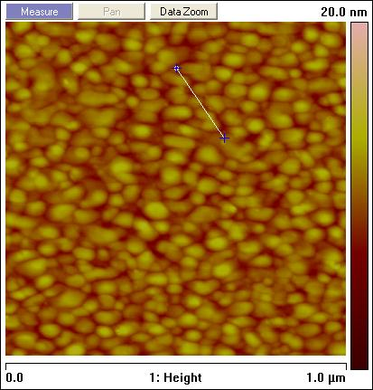
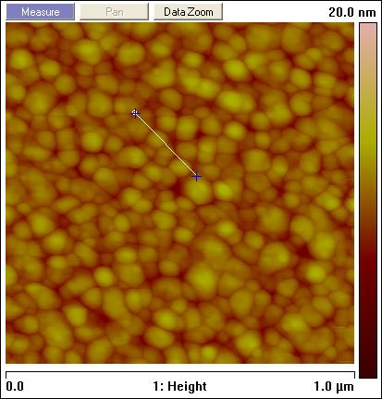
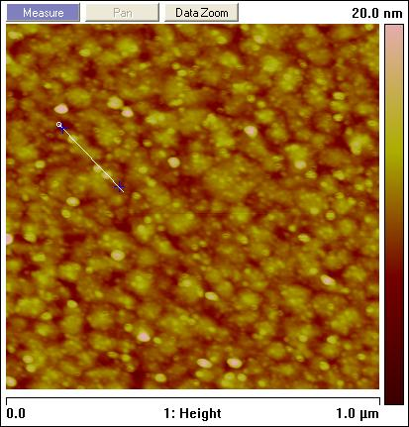
Supplementary Figure S6. AFM images and corresponding line profiles of a) bare gold, b) gold + HDT, and c) gold + HDT + AuNp (10 nm, 2 hrs incubation)
a)
b)
c)
Surface | Au | Au/HDT | Au/HDT/AuNp
Roughness (Ra, nm) | 1.18 | 0.99 | 1.39
Height (nm) | 3.68± 0.46 nm | 2.81±0.50 nm | 10.45±1.14 nm
The average (Ra) roughness of the fabricated gold electrode surfaces calculated using AFM.

Slide 9
Supplementary Fig. S7. Cyclic voltammograms of planar gold electrode (black curve), 1,6-HDT modified gold electrode (blue curve) and 10 nm Au nanoparticles modified electrode (red curve) in 0.5 M H₂SO₄. Potential scan rate was 100 mv/s.

Slide 10
Supplementary Fig. S8. (A) and (B) show Nyquist plots of Au/1,6-HDT/IgG biosensor after incubation (2 h) with 10⁴ and 10⁵ cfu/ml of negative controls, HKSA and HKST. (C) Nyquist plots of different concentration of HKEC incubated with PrG-thiol modified planar gold electrode.

