Slide 1

Fire Alarms and Exit Signs
2010 NATIONAL MODEL CONSTRUCTION CODES
Philip Rizcallah, P. Eng
NRC Canadian Codes Centre
February 2011

Slide 2
Introduction
Presentation is part of a series on the 2010 National Model Construction Codes
Model codes developed by Canadian Commission on Building and Fire Codes
These codes must be adopted by provincial/territorial authorities to become law
Notes:
This presentation is part of a series of 13
on the 2010 National Model Construction Codes.
It is important to note that the model codes, which are developed
by the Canadian Commission on Building and Fire Codes,
must be adopted by provincial/territorial authorities to become law.
This may mean that code requirements enacted by legislation within
your province or territory might differ from what is presented here.
Please check with your local authority.

Slide 3
Outline
Fire and smoke alarms/detectors
  Detection
  Audibility
  Supervision
Exit signs
  Pictogram
  Photoluminescent signs
Notes:
Today’s presentation will focus on fire alarm and exit sign changes that have been included in the 2010 National Building Code Parts 3 and 9, as well as the National Fire Code of Canada.
The first part of the presentation will focus on technical changes related to detection placement, audibility, and supervision of fire alarm systems.
The last part of the presentation will conclude with newly introduced requirements for exit signs.

Slide 4
Fire Alarm System Exceptions
Buildings with an automatic sprinkler system
  Exceptions
    NFPA 13 D “Sprinkler Systems for 1-2 Family Dwelling Units
    and Manufactured Homes”
    Fewer than 9 heads
  Rationale to allow cost effective incentive to sprinkler installation
  in homes
  Does not preclude smoke alarm requirements in dwelling units
Notes:
Relaxations have been introduced permitting the exemption of a fire alarm systems in all buildings where a sprinkler system has been installed. The exception permits the fire alarm system to be waived where an automatic sprinkler system has been installed according to NFPA 13D “Sprinkler Systems for 1-2 Family Dwelling Units and Manufactured Homes.”
In addition, a similar relaxation has been introduced in buildings with fewer than 9 heads.
The relaxations were justified based on the additional cost of the system and expected cost of monitoring. Since the requirement for a sprinkler system was seen as an upgrade in these individual dwelling units, the committee concluded that the added cost could not be justified. This relaxation was seen as an incentive for 1 or 2 family dwelling to install sprinkler systems.
It should be noted that this relaxation does not preclude the requirement for smoke alarms.

Slide 5
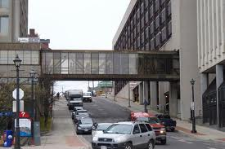
Buildings Interconnected by Walkways
Treated as separate buildings for purpose of fire alarm installation
Clarification to treat buildings as standalone
Notes:
The continuity of fire alarm systems in multiple interconnected buildings was clarified, as the current code provisions were vague on this issue. Although it is clear that when the building is separated by a firewall with openings the code requires both sides of the building to be treated as one building in the case of the fire alarm system.
However in the case of buildings interconnected by walkways identified in Parts 3 and 9, the fire alarm application was not as clear.
This change was deemed to be a clarification of the intent to treat buildings from the perspective of fire alarm requirements as stand-alone when separated by a tunnel, walkway or vestibule.

Slide 6
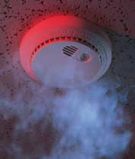
Entrance to Interconnected Walkways
Smoke detectors installed near entrance to walkways
or vestibules
Exception permitted for Group F Industrial Occupancy
Notes:
The 2005 Codes did not provide occupants of adjoining buildings with notification of possible fire that could impact them by way of the interconnected walkway.
This change introduces a requirement for smoke detectors to be installed near the entrance to walkways of adjoining buildings, where a fire alarm system is required. These detectors would serve to notify occupants of the adjacent building of a fire condition in the subject building.
An exception is permitted in Group F Industrial Occupancies which are permitted to have heat detectors in lieu of smoke detectors, in order to reduce the possibility of false alarms.

Slide 7
Commissioning
Applies to life safety and fire protection systems
“…the commissioning of these integrated systems must be performed as a whole to ensure the proper operation and inter-relationship between the systems”
Notes:
Although the National Building and Fire Codes require individual fire protection and life safety components to be commissioned to ensure proper operation there is no specific requirements that require integrated systems to be tested as a whole.
This change requires the life safety and fire protection systems, which are integrated, to be commissioned to operate as intended. All to often one trade will commission a specific component of the life safety system or fire protection system (e.g. door hold-open device) but where there is reliance on the operation of another system (i.e. fire alarm) to ensure the function of this door, that interconnection is not confirmed.
The 2005 Codes had no requirements that the integrated systems must be tested as a whole.
7

Slide 8

Commissioning continued…
Life safety and fire protection
systems include:
  Fire alarm
  Sprinklers
  Standpipes
  Smoke control
  Ventilation
  Pressurization
  Door hold open
  Elevator recalls…
Notes:
The commissioning requirements will now include integrated systems such as fire alarms or smoke alarms connected to, sprinklers, smoke control, ventilations, pressurization, door hold-open devices, elevator recalls, fire shutters etc.
8

Slide 9
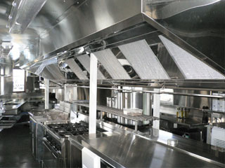
Annunciator and Zone Indication
Fire extinguishing system
NFPA 96
  “Ventilation Control and Fire Protection of Commercial Cooking Operations”
Benefit reiterates often
missed requirements
Notes:
In the case of commercial kitchen ventilation systems, the Standing Committees noted that designers often miss the requirements for supervisory monitoring of the fire extinguishing system required by NFPA 96. A specific reference to NFPA 96 has been introduced to reiterate these often missed requirements.

Slide 10
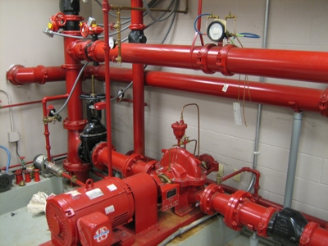
Fire Pump Supervision
Electrically supervised
as stipulated in NFPA 20
  “Installation of Stationary
  Pumps for Fire Protection”
Benefit reiterates often missed requirements
Notes:
In the case of fire pump installations, the Standing Committees noted that designers often miss the requirements for supervisory monitoring for such things as control valves, loss of power, phase rotation, etc. These are required under NFPA 20 which is referenced by Part 3 of the National Building Code. A specific reference to NFPA 20 has been introduced to reiterate these often missed requirements.

Slide 11
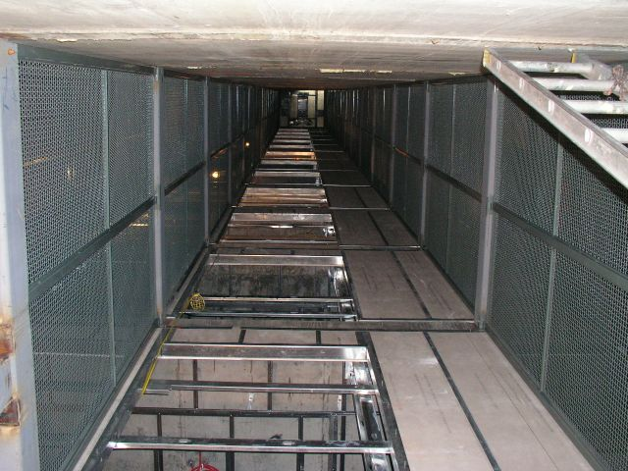
Fire Detectors
Required
  in elevator hoistway and dumbwaiter shafts
  where sprinkler not installed
  in hoistway or shaft
The term “throughout” deleted for clarification of intent
Notes:
Recent editions of NFPA 13 no longer require sprinkler protection in elevator shafts. It has been interpreted by some code users that since the building is sprinklered, there is no need to install fire detectors in the elevator shaft.
This change makes it clear that fire detectors are required in the elevator shafts, regardless of whether the building is sprinklered. This new requirement would apply to cases where the sprinkler has not been extended into the shaft.
In addition the term “throughout” causes confusion where users have interpreted that “throughout” would supersede the requirements in the referenced NFPA standards and require sprinklers in areas specifically exempted i.e. in some small closets, attics, etc. This term has been removed to reduce this confusion.

Slide 12
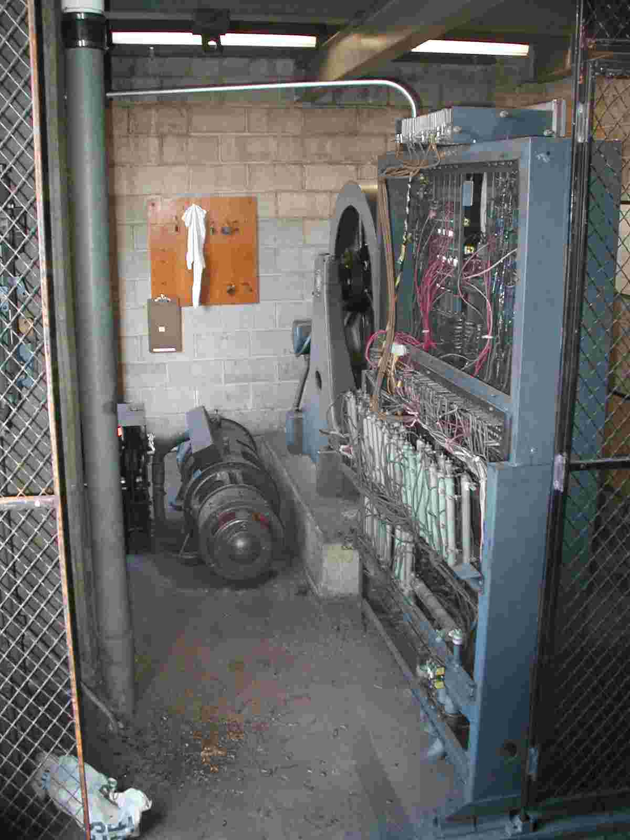
Elevator Machine Room
Smoke detectors
  required in elevator machine rooms
  must recall elevator served
  by that machine room
Notes:
There are no requirements within the 2005 National Codes to require elevator rooms that experience an alarm condition to recall elevators that are being served by that room.
The CSA-B44 standard does require that this detector be located in the elevator machine room. This requirement reiterates the CSA B 44 requirement that is often missed by installers and designers.

Slide 13

Smoke Detectors in Stair Shafts
Required in shafts except
  Group A, Division 4 occupancy, or
  an open storage garage
Notes:
The NBC requires that each exit stair shaft be equipped with a smoke detector. This change permits an exception to this requirement in open air type assembly occupancies and open storage garages. The exception is permitted on the basis that current detectors with electronics are not tested to temperatures below 0 degrees.
The committee noted that providing smoke alarms in stairwells that are serving open-air garages does not provide any life safety benefit, as these areas are generally open to the environment.

Slide 14

Audibility of Alert Signals
Audible in continuously staffed locations, or
throughout floor area
Notes:
The change clarifies the operational requirements of the alert signal on a two stage fire alarm system.
Removal of the words “throughout the floor area in which they are installed” clarifies that the alert signal may sound at a continuously staffed location. This clarifies the intent of the provision to allow the alert signal to sound at a designated staffed located rather than throughout the floor area unless there is no continuously staffed area. In that case the alert signal will need to sound throughout the floor area.
14

Slide 15
Smoke Alarms in Residential Suites
Smoke detectors in lieu of smoke alarms where:
  Independently sounding audible signals
  Conforms to CAN/ULC-S524
  Form part of fire alarm system
Permitted if
  Designated location
  Sound localized alarms within individual suites
Notes:
This change allows suites of residential occupancy to be equipped with smoke detectors in lieu of smoke alarms. The change recognizes certain smoke alarms with sounder base installations (essentially an independent smoke detector functioning as a smoke alarm) that may be the choice of installation in some hotels, motels and dormitories.
These detectors, although functioning remotely in the individual suites, would be connected to a fire alarm panel thus providing additional supervision of the detectors in the individual rooms. These devices would be required to follow the inspection frequencies of CAN/ULC-S536, “Inspection and Testing of Fire Alarm Systems,” as per the National Fire Code.
15

Slide 16
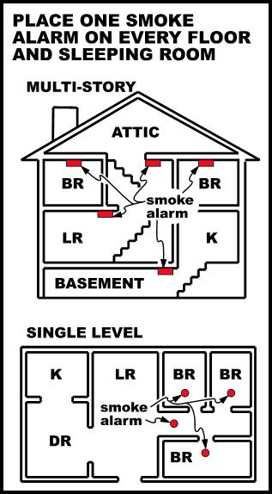
Fire and Smoke Alarms
Smoke alarm shall be installed
in bedrooms
Fires in sleeping rooms are the second highest cause of fire deaths
Notes:
16
This is considered one of the more significant fire alarm technical changes affecting homes.
Smoke alarms are now required to be installed in each bedroom, (this is in addition to the corridors outside the bedrooms, and each storey including basement) of a home.
Statistics have shown that next to kitchen fires, fires originating in sleeping rooms within dwelling units account for the second highest causes of fire deaths in homes. Smoke alarms located only in corridors outside the sleeping rooms may cause a delay in notifying occupants within the sleeping rooms of a fire especially if the fire originates within that room with the door closed.
The benefits are:
the audibility levels within the sleeping room will be enhanced with the closed door, and
Secondly smoke originating in a sleeping room will not be delayed in activating the alarm thus providing early notification to occupants.
Interconnected devices between all alarms provides additional notification.
Smoke alarms located within the corridor will be still be required as they are better capable of detecting a fire originating outside of the room.

Slide 17
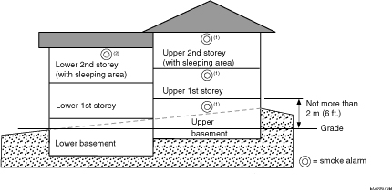
Smoke Alarm Location – Homes
Split level within home now only required on upper level of each floor
Notes:
Placement of smoke alarms is now based on the concept “floor space” not “level”. Therefore in staggered level homes the placement of the detector is based on the highest of the two levels within that floor space with consideration for the area of coverage for the smoke alarm.

Slide 18
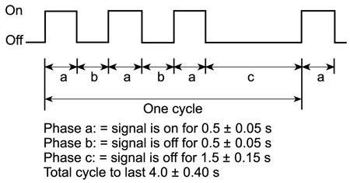

Smoke Alarm Signal
Smoke alarm shall
  meet the temporal pattern, or
  be a combined temporal pattern and voice relay
    Improve audibility and early notification
Notes:
This change introduces a new temporal pattern for smoke alarms used in residential occupancies. This sound pattern corresponds to that currently required for fire alarms.
The change was based on research and review of studies conducted on the effectiveness of alarms in waking children and the elderly.
The studies have demonstrated that possibly as little as 6% of children aged 6 to 15 awoke reliably to the standard high-pitch beeping alarm signal which is typical in households today. Installed in the hallway, the signal is usually received at around 60 dBA at the pillow. When the sound level is increased to 89 dBA at the pillow, by placing the sounder above the bed, 50% of the children awoke and only 29% of those 6-10 years old.
Alternative signals were also tested; the child’s mother's voice, an actor’s voice, a low-pitch T-3 signal and the standard high-pitch alarm. All the signals were tested at night in the child’s home at 89 dBA. Results show that the mother’s voice was the best signal to awake the child, then the actor’s voice and the low pitch T-3 alarm. The standard alarm performed the worst with 27% of the children not awaken after 60 seconds.
Combined with the bedroom installation, this measure will improve the effectiveness of evacuation in home.

Slide 19
Intelligibility
Applies to voice communication system
  Broadcasting pre-recorded, synthesized, or live messages
  Requirement
    Voice intelligibility meeting or exceeding measurable
    and quantifiable criteria (common intelligibility scale score of 0.70)
Notes:
19
The 2005 NBC currently asks for intelligible messaging for voice communication systems; however it is unclear what is expected by this term “intelligble”.
It was noted that in several facilities the intelligibility of messages through a voice communication system varies from very poor to very good, and there is no consistency.
The change introduces a measurable and quantifiable value 0.70 common intelligibility scale (CIS) for the voice communication system required to be installed in buildings. There is further guidance on the CIS with a reference to NFPA 72.

Slide 20
Voice Communication System
Voice communication system required
  2-stage fire alarm system installed
  Occupant load greater than 1000
Notes:
20
Notwithstanding the high building requirements and with the exception of Group B, Division 1, and Group F, Division 1 occupancies, a voice communication system is required under the 2010 NBC in all buildings equipped with a two stage fire alarm system where the occupant load exceeds 1000 persons.
This change was derived as a result of research conducted by a Task Group into the evacuation times and human behavior during alarm initiation in various occupancies. It was concluded that providing messaging to the occupants during an alarm was a critical factor in improving evacuation from a building.

Slide 21
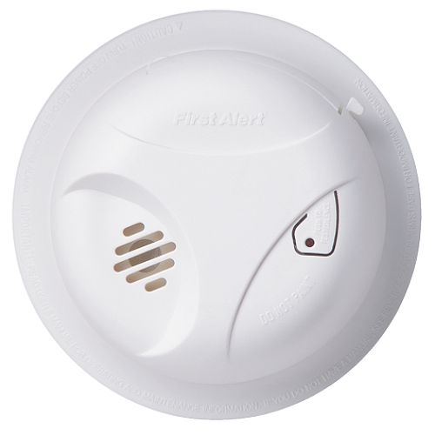
Fire and Smoke Alarms
Smoke alarm shall
  minimize potential tampering with smoke alarm (silencing)
Manual silence feature
Notes:
21
This change introduces the requirement for manually operated silencing switch on the circuitry of the smoke alarm.
It has been shown that smoke alarms that do not have a manually operated silencing device incorporated within the circuitry are prone to tampering and disconnection due to false alarms or annoyance. This change will allow manual silencing of the alarm in the event of a nuisance alarm.

Slide 22
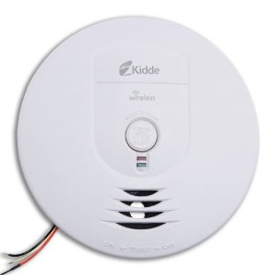
Power Supply
In addition to permanent
connection with power supply,
battery backup for 7 days normal followed by 4 minutes of alarm
Notes:
Under the previous codes, there were no requirements for supplemental power supply for smoke alarms. This change introduces a requirement for an alternate power supply (battery back-up) for smoke alarms in homes.
As a result of the extended power outages that occurred in both Ontario and the Maritimes in 2003, various provinces expressed concern over the lack of Code provisions requiring secondary power supply to smoke alarms installed in residential occupancies. The risk of fire increases during power outages as building occupants rely more on candles for light and portable, exposed-flame appliances for cooking and heating.
Providing the battery back-up capability in smoke alarms will reduce the probability of undetected fires. While people may generally rely on the hard-wired power supply, cautions are generally announced when there are power outages. Reminders in those announcements to check smoke alarm batteries would further reduce the likelihood of fire deaths and property loss.

Slide 23
Voice Communication
2-way means of communication
Instead of
2-way communication system
in each floor area, with connections to …
Notes:
The 2005 wording states that a 2-way communication system needs to be provided on each floor for voice communication. This was viewed as restrictive of new technologies that could be utilized to meet the intent of the 2-way communication.
The change creates a more performance-based requirement and allows new technologies to be considered.

Slide 24
Residential Care Facilities
Group B, Div. 3 (care occupancy)
  More stringent than Group C
  Less stringent than Group B, Div. 2
  (treatment occupancy)–Relaxations…
Notes:
A new Group B Division 3 Residential Care Occupancy has been developed. This occupancy is regarded as falling between the current Group B Division 2 Care and Detention and the Group C Residential Occupancy. With regards to fire alarm systems one relaxation has been introduced. This will be explored in the following slide.
24

Slide 25

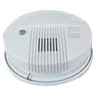
Residential Care Facilities
Permits use of smoke alarms within sleeping rooms
and suites of residential care facilities in lieu of smoke detectors
Notes:
The change allows for a relaxation by permitting the use of smoke alarms within sleeping rooms and suites of residential care in lieu of smoke detectors.
It should be noted that the requirement for fire alarm system with smoke detectors has not been waived for the remainder of the building ie. general area corridors, common spaces, etc.
25

Slide 26

Exit Signs
Green pictograms
conforming to ISO standards
Conform to universal sign
Language independent
Internationally recognized
Harmonize internationally
Notes:
The new pictogram sign calls for the green “running man” image and directional arrows in place of the traditional red EXIT or SORTIE signs.
The new format conforms to International Standards Organization (ISO) symbols now commonplace in the European Union and many other countries.
The benefit of these new signs include:
conformity to universal sign,
harmonization with other jurisdictions,
not language dependant, and
International recognition.

Slide 27
Exit Signs
Recognizing that
photoluminescent technology
  continues to function when
  building emergency power fails
  provides options to designers
  and easier installation
all exit signs need to be listed according to CAN/ULC-S572-10, “Photoluminescent and Self-luminous Exit Signs and Path Marking Systems”
Notes:
Exit signs Continue...
The 2010 Code has included design parameters for the use of photoluminescent exit signs – a technology that adherents promote for both safety and energy conservation reasons.
Photoluminescent signs absorb and store light at levels as low as 5 lux and, once charged, can provide illumination for several hours in the absence of light. They can function in combination with conventional or emergency lighting without having to be wired into a power system, and they require negligible maintenance because there are no bulbs to replace.
The code recognizes this available photoluminescent technology which:
will continue to function if building emergency power fails,
provide options to designers, and easier installation and
All photoluminescent exit signs need to be listed

Slide 28
Summary
Clarifies locations where detection/supervision is required
  Approach to walkways
  Elevator shafts
  Elevator rooms
  Fire pump annunciation
  Kitchen hood extinguishing
  Bedrooms
Commissioning of integrated life safety systems
Voice communication systems and intelligibility requirements
New pictogram requirements for exit signs

Slide 29
www.nationalcodes.ca
Questions?
Send them to us at codes@nrc-cnrc.gc.ca
Thank you!

