Slide 1
Heating, Ventilating and Air-Conditioning and Service Water Heating
Mihailo Mihailovic
March 2013
Notes:
Welcome. My name is Mihailo Mihailovic.
This presentation focuses on two new Subsections (9.36.3. and 9.36.4.) of the National Building Code of Canada (NBC) 2010 that deal with heating, ventilating and air conditioning (HVAC) and service water heating systems.

Slide 2
Introduction
Presentation is part of a series of four
Model code developed by Canadian Commission on Building and Fire Codes
National Building Code of Canada 2010 (NBC) must be adopted by provincial/territorial authorities to become law
Notes:
This is the third in a series of four presentations on the new energy efficiency requirements for housing and small buildings that were recently incorporated into the NBC 2010.
it is important to note that the NBC is a model code developed by the Canadian Commission on Building and Fire Codes and must be adopted by provincial/territorial authorities to become law. This may mean that code requirements enacted by legislation within your province or territory might differ from what is presented here. Please check with your local authority.

Slide 3
Outline
  Heating, Ventilating and Air-conditioning (HVAC) requirements
    Subsection structure
    Equipment efficiency
    Ducts and pipes
    Heat recovery from air over interior pools
  Service Water Heating requirements
    Subsection structure
    Equipment efficiency
    Pipe insulation
    Controls
  Solar
Notes:
For the HVAC requirements, this presentation will look at:
the overall subsection structure
equipment efficiency development
how ducts and pipes are addressed
requirements for heat recovery ventilators, and
requirements for interior pools.
For the service water heating requirements, the presentation will look at:
the overall subsection structure
equipment efficiency development
requirements for pipe insulation, and
equipment controls.
There will also be a brief discussion on how to address solar technologies.

Slide 4
HVAC – subsection structure
9.36.3. HVAC Requirements
    9.36.3.1. Scope and Application
    9.36.3.2. Equipment and Ducts
    9.36.3.3. Air Intake and Outlet Dampers
    9.36.3.4. Piping for Heating and Cooling Systems
    9.36.3.5. Equipment for Heating and Air-conditioning Systems
    9.36.3.6. Temperature Controls
    9.36.3.7. Humidification
    9.36.3.8. Heat Recovery from Dehumidification in Spaces
    with an Indoor Swimming Pool or Tub
    9.36.3.9. Heat Recovery from Ventilation Systems
    9.36.3.10. Equipment Efficiency
    9.36.3.11. Solar Thermal Systems
Notes:
Here is the breakdown of the topics addressed in the new 9.36.3. HVAC subsection.
There are scope and application requirements as well as requirements for:
equipment sizing and ducts
air intakes and outlets
piping for heating and cooling systems
heating and cooling system equipment
temperature controls, and
humidification.
There are also detailed provisions dealing with heat recovery from dehumidification
in areas having indoor swimming pools or spas.
If installed, there are provisions for heat recovery ventilation.
Lastly, an extensive list of equipment efficiencies and minimum performance levels is provided, as well as some initial provisions dealing with solar thermal equipment.

Slide 5
HVAC – equipment efficiency
  List of equipment developed based on:
      Model National Energy Code of Canada for Houses 1997
      National Energy Code of Canada for Buildings 2011
      Additional equipment (identified in committee meetings)
  Performance based on validation requirements,
  market analysis and industry practice
  Minimum equipment efficiencies
      Standards and performance referenced for other technology
      Requirements for air-conditioners, where installed
  Energy Efficiency Regulations absolute floor
  for performance
Notes:
In the HVAC subsection, equipment efficiency is addressed in Article 9.36.3.10.
The equipment list is a compilation of the original list in the Model National Energy Code of Canada for Houses 1997, the list in the National Energy Code of Canada for Buildings 2011, and additional equipment identified during committee meetings.
Some of the performance requirements are based on what is required for the validation to meet the performance target. Other performance requirements are based on a market analysis, and yet others were chosen to accommodate current industry practices while setting minimum standards for energy efficiency.
Other technologies are referenced throughout the table and, even though air conditioning is not mandatory within the Code, air conditioner requirements are listed. This provides the user with minimum values that must be met.
It should be noted that no performance requirement is lower than what is listed in the federal Energy Efficiency Regulations.

Slide 6
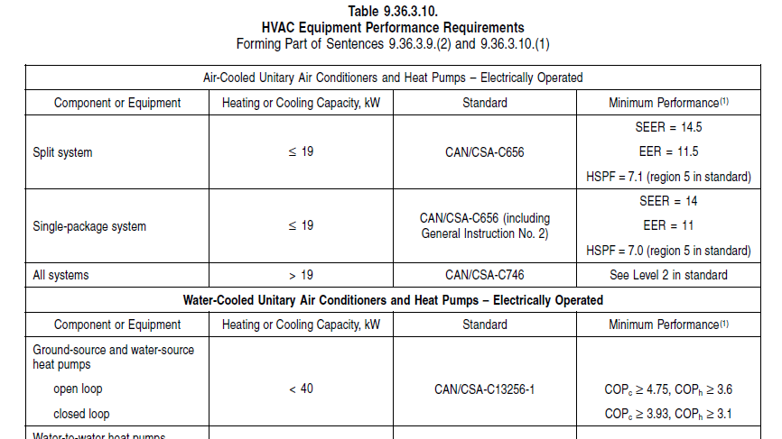
HVAC – equipment efficiency
  9.36.3.10. Equipment Efficiency Table
Notes:
Here is an excerpt from the table in Article 9.36.3.10.
The table lists several types and sizes of equipment that may be found in Part 9 Housing and Small Buildings, but it does not show all possible equipment.
Where found, the appropriate performance standards are listed, as well as the corresponding minimum performance requirement.
Where the number of possible requirements in the standard would make the list too long for the table, the phrase “In the Standard” is used instead.

Slide 7
HVAC – ducts and pipes
  Prescriptive HVAC requirements
    Proper sizing of system and ducts with Sections 9.32 and 9.33
    Outside ducts and piping insulated to above-grade wall RSI value
    Heat recovery ventilators (HRV) not required, but
      Where installed, minimum sensible heat recovery efficiency required
        60% in mild locations (when tested at 0°C)
        55% in cold locations (when tested at 0°C and -25°C)
    Dampers required (some exemptions), thermostats
    Controls to prevent simultaneous heating and cooling
      Specific heat pump controls for supplementary heating
    Piping installed as per Section 9.33.8.
Notes:
Some other aspects of HVAC systems that are addressed include:
proper system and duct sizing in accordance with Sections 9.32. and 9.33., and
insulating of ducts and piping installed outside to levels equivalent to the exterior walls.
While heat recovery ventilators (HRV) are not mandatory, requirements are provided for where they are installed. In such cases, the HRV must meet minimum sensible heat recovery efficiencies based on testing temperatures for that HRV and for the climatic conditions of the building’s location.
There are requirements for dampers, except where regulations do not permit their use or on systems that are intended to run continuously.
There are also controls to prevent heating and cooling from coming on at the same time, as well as controls for heat pumps.
Lastly, piping insulation referenced in Subsection 9.33.8. does not currently specify a thermal performance for that insulation.

Slide 8
HVAC – ducts and pipes
Duct insulation solution
    Addresses construction types having low profiles
      Insulated duct installed under floor over shallow foundation
      Due to transportation limitations
    Increase side insulation to compensate for bottom insulation
    Performance expected to be close to equal
Notes:
Another acceptable solution was developed for duct insulation, which is considered equivalent to insulating the duct equally all around.
This solution allows the user to increase the side insulation by a certain amount to compensate for situations where the bottom insulation must be reduced due to certain construction types, or where there are transportation limitations, as may be the case with single-section manufactured housing or in floors over garages.
Tables are provided that give increased side insulation values when the bottom value is set at a reduced value.
The thermal performance of the ducting system insulated in this way is therefore expected to equal a duct system that has the same insulation all around.

Slide 9
HVAC – heat recovery from air over interior pools
Notes:
This diagram shows the intent of what Article 9.36.3.8. is describing with respect to heat recovery from air in areas with indoor swimming pools or spas.
The best way to start is to look at the pool size. If the pool is less than 10 square metres in area and has a pool cover, the pool cover must meet minimum insulation values. These values are set to current industry standards.
If there is no cover, or if the pool is greater than 10 square metres, there are two choices. One is to install an HRV with minimum 40% sensible heat recovery. The other is to install a dehumidifier that is a non-portable mechanical system or uses a desiccant. This dehumidifier must be capable of providing at least 80% dehumidification.

Slide 10
HVAC – gas and propane fireplaces/stoves
  Performance requirements currently not listed
  Testing standard being updated
  Applies to decorative appliances
  Code lists prescriptive requirements
    Direct-vented
    No standing pilot lights
  To be revisited when standard available
Notes:
Following public review comments, it was determined that providing minimum performance requirements for gas and propane fireplaces or stoves was not feasible, as current performance levels are inconsistent with equipment types that are widely available on the market.
The current CSA standard for these units is being revised to provide better testing parameters, as well as performance levels, and to better define what is a decorative appliance.
As a result, instead of requiring a minimum performance rating, a prescriptive requirement mandates that the appliance be direct-vented and have no standing pilot light.
Once the CSA standard has been revised, this requirement will be revisited.

Slide 11
Service water heating – subsection structure
9.36.4. Service Water Heating Systems
    9.36.4.1. Scope and Application
    9.36.4.2. Equipment Efficiency
    9.36.4.3. Solar Domestic Hot Water Systems
    9.36.4.4. Piping
    9.36.4.5. Controls
    9.36.4.6. Indoor Swimming Pool Equipment Controls
Notes:
Here is the breakdown of the topics addressed in the service water heating subsection.
It is very similar to the HVAC subsection, with respect to:
scope and application
tables with equipment efficiencies
provisions for solar domestic hot water systems
provisions for piping
controls, and
swimming pool equipment controls.

Slide 12
Service water heating – equipment efficiency
  Minimum equipment efficiencies
      Electric, gas, oil
      Tankless/storage tank type
      Pool heaters included
      Combo systems (water and heating)
  Storage tanks need to be insulated
Notes:
The equipment efficiencies are addressed in Article 9.36.4.2.
The table provided is very similar to the table in the HVAC subsection. It addresses:
three different, yet common, fuel sources (electric, gas, oil)
tankless and storage tank type equipment
pool heaters, and
combination systems.
The combination systems, which provide both hot water and space heating, are actually listed in both HVAC and service water heating tables.
There is also a requirement that all storage tanks be insulated. Insulation values are listed in the article’s sentences.

Slide 13
Service water heating – pipe insulation and controls
Insulate outlet and inlet piping within two meters of storage or heating vessel
Pipe insulation for
    Piping located outside or in unconditioned spaces
    Recirculation piping: 12 mm diameter insulation
Controls for
    Storage tank temperature
    Pool heater shut down
Notes:
Piping within two metres of the outlet and inlet of the storage or heating vessel must be insulated using appropriate pipe insulation.
Piping located outside or in unconditioned spaces must be insulated to the same levels as the exterior walls, and continuously operating re-circulating pipes must be insulated using appropriate pipe insulation with a diameter that is no less than 12 mm.
Controls must be installed for the temperature of the storage tanks and for automatically shutting down pool heaters when not in use.

Slide 14
Solar thermal technology
Applies to HVAC and service water heating
    Solar space heating technology
    Solar water heating technology
Requirement (separate Article)
    Conform to manufacturer’s design and installation procedures, or
    Installation according to National Plumbing Code of Canada 2010
      Exception: all storage tanks must be installed in conditioned space
Related standards not listed under equipment efficiency
Notes:
Policy advice from the Commission is to remain silent on renewables, as was done for the National Energy Code.
However, it was agreed that if standards were available for certain types of renewable technology, they should be mentioned, keeping in mind that there is no credit for using renewables.
Solar thermal technology is becoming more readily used for HVAC and service water heating systems. The requirement is to conform to the manufacturer’s design and installation procedures or follow the National Plumbing Code of Canada 2010, which lists the standards. The only exception is that all storage tanks must be installed in conditioned spaces.
It was decided that the standards not be listed in the tables to avoid putting restrictions on the use of renewables.

Slide 15
Questions?
www.nationalcodes.nrc.gc.ca
Thank you
Notes:
This concludes the presentation on energy efficiency requirements related to HVAC and service water heating for housing and small buildings. Should you have any questions, please do not hesitate to contact us. Thank you.

