Slide 1

Residential Care
2010 NATIONAL MODEL CONSTRUCTION CODES
Philip Rizcallah, P. Eng
NRC Canadian Codes Centre
February 2011

Slide 2
Introduction
Presentation is part of a series on the 2010 National Model Construction Codes
Model codes developed by Canadian Commission
on Building and Fire Codes
These codes must be adopted by provincial/territorial authorities to become law
Notes:
This presentation is part of a series of 13
on the 2010 National Model Construction Codes.
It is important to note that the model codes, which are developed
by the Canadian Commission on Building and Fire Codes,
must be adopted by provincial/territorial authorities to become law.
This may mean that code requirements enacted by legislation within
your province or territory might differ from what is presented here.
Please check with your local authority.

Slide 3
Rationale for Change
Provincial and territorial regulators looking for more flexible alternative to Group B Division 2
Owners and operators of care facilities burdened with current Group B Division 2 classification in all cases
Notes:
There are classes of care facilities where persons receive special or supervisory care because of cognitive or physical limitations. These include, but are not limited to: retirement homes, certain group homes, supportive housing, children’s custodial homes, convalescent homes, residential care facilities, and sanatoria without detention quarters.
Residents of these care facilities may be adults or children and may receive care services under a variety of different programs/models. These programs/models range from a highly supported setting in which residents with multiple disabilities receive 24 hr. supervisory care to a low support setting in which adult residents are capable of independent living but receive periodic visits from an off-site caseworker.
As these care facilities are found across Canada, PTPACC has indicated among its priorities, to consider ways to amend the model National Building Code to address the issue of whether, and how, to establish a new occupancy classification and related Building Code requirements that are more stringent than those that are applied to residential uses, but less stringent than those that are applied in care and detention uses.
3

Slide 4
Objectives of the Commission
Maintain level of safety proportionate to identified risk
Provide cost-effective alternatives
Clarify areas of misinterpretation
Notes:
Due to the nature of occupancy, these premises generally require more fire and structural safety features than those found in a residential occupancy (e.g., Group C Major Occupancy), but do not generally require the extensive fire and structural safety features found in institutional uses such as hospitals or nursing homes (i.e., Group B, Division 2). Currently, owners of such facilities are often burdened with the capital cost of meeting the higher B2 requirements, without corresponding benefit to their clients or occupants.
This new series of technical changes to the National Building and Fire Codes establish requirements that are more stringent than those applied to residential uses, but less stringent that those currently applied to care and detention uses.
4

Slide 5

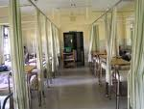
Residential Care
New Definitions
Construction Type
Design Criteria
Sprinklers
Smoke Alarms
Notes:
Let’s start with the new definitions associated with care occupancies.

Slide 6
Care Occupancy
Occupancy Classification
Care and Detention Occupancy
Groups B Div 1 and 2
NEW
Detention
Group B Div 1
Treatment
Group B Div 2
Care
Group B Div 3
Notes:
The unshaded portion illustrates the occupancy classifications in the 2005 NBC. The 2010 Code has introduced a new classification Group B division 3.

Slide 7
2005 Classification
Care or detention occupancy means the occupancy or
use of a building or part thereof by persons who require special care or treatment because of cognitive or physical limitations or by persons who are restrained from, or are incapable of, self-preservation because of security measures not under their control
  Group B Division 1 - Detention
  Group B Division 2 - Care
Notes:
7
Under the 2005 code, care occupancies were treated similar to treatment occupancies. In other words, requirements for hospitals could be applied to residential care facilities where occupants were not receiving the type of care received by incapacitated residents. The 2005 definitions read as follows:

Slide 8

Definition – Treatment
… provision of medical or other health-related intervention to persons... may render them incapable of evacuating to a safe location without the assistance of another person
Notes:
8
Read Definition
Treatment means the provision of medical or other health-related intervention to persons, where the administration or lack of administration of these interventions may render them incapable of evacuating to a safe location without the assistance of another person.
Treatment
“Treatments” may include such things as surgery, intensive care, and emergency medical intervention. Treatment services differ from the services provided by care occupancies like personal care assistance or the administration of medication, and from those provided by business and personal services like dentistry or day procedures.
The ability to evacuate unassisted implies that a person is capable of recognizing and responding to an emergency given their physical, cognitive and behavioural abilities. This person is able to move to a safe location without the assistance of another person. For example, such a person must be able to arise and walk, or transfer from a bed or chair to a means of mobility, and leave the building or move to a safe location.

Slide 9
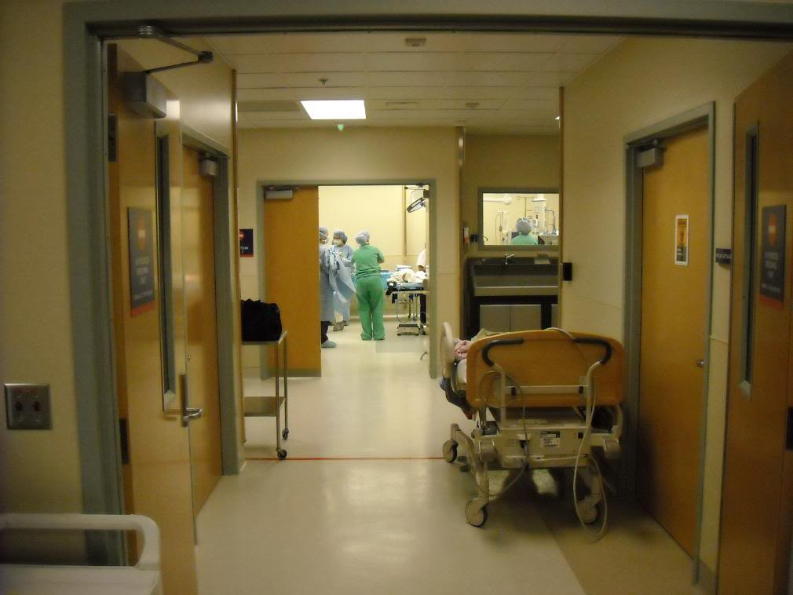
Definition – Treatment Occupancy
… provision of treatment
where overnight accommodation is available to facilitate the treatment
Notes:
9
Treatment occupancy means the occupancy or use of a building or part thereof for the provision of treatment where overnight accommodation is available to facilitate the treatment. Examples would include hospitals and palliative care centres.

Slide 10

Definition – Care
… provision of services other than treatment by, or through, facility care management to residents who require these services because of cognitive, physical
or behavioural limitations
Notes:
(Read Definition)
Care means the provision of services other than treatment by or through facility care management to residents who requires these services because of cognitive, physical or behavioural limitations..
What is important to note here, is that there is a distinction between care and treatment, the definition for treatment shown in the preceding slides.

Slide 11

Definition – Care Occupancy
… occupancy or use of a building or part thereof where care is provided to residents
Now referred to as GROUP B DIV 3
  Exceeding 24 hours
  By or through facility management
Notes:
(Read the definition)
Support services rendered by or through care facility management refer to services provided by the organization that is responsible for the care for a period exceeding 24 consecutive hours. It does not refer to services provided by residents of dwelling units, or suites, or to services arranged directly by residents of dwelling units or suites with outside agencies.
In the context of care occupancies, these services may include a daily assessment of the resident’s functioning, awareness of their whereabouts, the making of appointments for residents and reminding them of those appointments, the ability and readiness to intervene if a crisis arises for a resident, supervision in areas of nutrition or medication, and provision of transient medical services. Services may also include activities of daily living such as bathing, dressing, feeding, and assistance in the use of washroom facilities, etc. No actual treatment is provided by or through care facility management.

Slide 12


Residential Care
New Definitions
Construction Type
Design Criteria
Sprinklers
Smoke Alarms
Notes:
Care Occupancies:
Let’s take a look at some of the new construction requirements.

Slide 13
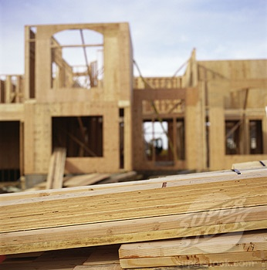
Construction
Allows options in types
of construction materials used
Notes:
Some construction requirements for the B3 residential care occupancy provide a relaxation form the current 2005 requirements for the Group B2 occupancy.

Slide 14
Construction
Maximum building area for combustible construction, sprinklered
Building Height | Group B Div 2 | Group B Div 3 | Group C
1 Storey | 2400 m² | 5400 m² | 7200 m²
2 Storeys | 1600 m² | 2700 m² | 3600 m²
3 Storeys | Not allowed | 1800 m² | 2400 m²
4 Storeys | Not allowed | Not allowed | 1800 m²
Notes:
14
Permission to construct B3 occupancies up to three stories in building height having a limited occupant load, using either combustible or non combustible construction under Part 3 of the NBC.

Slide 15
Construction
Permitted combustible up to 3 storeys with building area
Notes:
One of the major differences between the B2 and B3 construction requirements is the option to build with combustible construction up to 3 storeys for buildings of a limited area.
Permission to construct B3 occupancies up to three stories in building height having a limited occupant load, using either combustible or non combustible construction under Part 3 of the NBC.
You can see here that the Group B3 construction requirements fall in between the Group B2 and C.
15

Slide 16
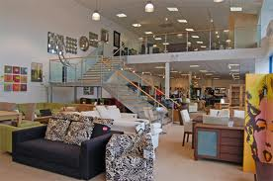
Construction
No mezzanine floor fire-resistance rating requirement
for one storey ≤ 600 m²
Notes:
Another relaxation is the elimination of the mezzanine floor rating requirements in smaller one-storey (< 600 m²) B3 occupancies.
16

Slide 17

Residential Care
New Definitions
Construction Type
Design Criteria
Sprinklers
Smoke Alarms
Notes:
Let’s move into the issues related to corridor and door widths

Slide 18
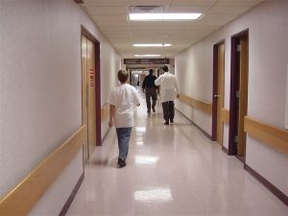
Corridor Width
Treatment where patients moved
in beds: 2400 mm
Treatment where corridors not used to move patients: 1650 mm
Care > 10 residents and corridors serve those residents: 1650 mm
Care ≤ 10 residents: 1100 mm
Notes:
18
In treatment occupancies where patients or residents are moved in beds, corridors must be at least 2400 mm in width.
In care or treatment occupancies where the corridors will not be used to move patients or residents in beds and in buildings of care occupancy with more than 10 residents and the corridors serve those residents must be 1650 mm.
In care occupancies with not more than 10 residents 1100 mm corridor width is permitted.

Slide 19
Ramp Width
Ramps serving residents’ sleeping rooms permitted to be 1100 mm
Notes:
19
The 2005 requirements stipulated a ramp width of 1650 mm where it served a patient or resident sleeping room. The new changes for B3 allow a ramp width of 1100 mm.

Slide 20
Stair Width
More than 10 residents
  Not more than 2 storeys above lowest exit level
    1100 mm
  Serves more than 2 storeys above lowest exit level
    1650 mm
Notes:
20
The 2005 requirements stipulated a stair width of 1650 mm where it served a patient or resident sleeping room.
The new changes for B3 allow a stair width of 1650mm where there are more than 10 residents and the stairwell serves more than 2 storeys above the exit level.
A further relaxation is permitted down to 1100 mm where there are more than 10 residents and the stairwell serves not more than 2 storeys above the exit level.

Slide 21
Stair Width
Not more than 10 residents
  Not more than 2 storeys above lowest exit level
    900 mm
  Serves more than 2 storeys above lowest exit level
    1100 mm
Notes:
21
Further relaxation where there is no more than 10 residents
900 mm where there are not more than two storeys above the lowest exit level,
The 1100 mm where there are more than two storeys above the lowest exit level,

Slide 22
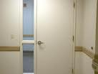
Door Width
2005 Code
  1050 mm
2010 Code
Any B3 Occupancy
  Clear width of 850 mm
Width based on the concept of one person providing assistance to another during evacuation
Notes:
22
The current requirements stipulated a door width of 1050 mm where it served a patient or resident sleeping room.
The new changes for B3 allow a door clear width of 850 mm regardless of the number of residents. The use of the term clear width implies that the opening must have an unobstructed width of 850 mm.

Slide 23

Residential Care
New Definitions
Construction Type
Design Criteria
Sprinklers
Smoke Alarms
Notes:
Moving on to the sprinkler requirements

Slide 24
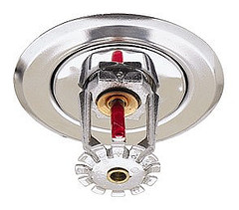
Sprinklers
NFPA 13 – most Group B Div 3 occupancies
  Occupant load exceeds 10, OR
  Greater than 3 storeys in building height
Notes:
In all cases Group B Division 3 buildings must be sprinklered. The new changes will allow relaxations on the type of sprinkler systems that are permitted to be used.
In the case were the occupant load exceeds 10 persons and the building has more than 3 storeys in height NFPA 13 must be utilized.
The concept of occupant load and number of residents is utilized throughout the requirements for care occupancy. Each term is deliberately applied. Occupant load includes all persons in the building, staff, and residents.
In the cases where residents is used it refers to those expected to reside in the premises not those that may come to work during a shift.

Slide 25
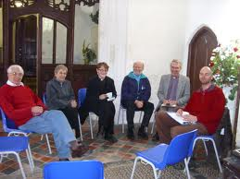
B3 Construction Sprinklers
NFPA 13R – B3 occupancies
  Occupant load not more 10, AND
  3 storeys or less in building height
Notes:
The first relaxation permits the use of NFPA 13R in buildings where the occupant load is not more than 10 and the building does not exceed 3 storeys in building height.

Slide 26
B3 Construction Sprinklers Relaxation
NFPA 13D – B3 occupancies
  Contains not more than 2 suites
  Not more than 5 residents throughout
  AND
  30 minute water supply demand can be met
Notes:
A second relaxation permits the use of NFPA 13D in buildings where the building
Contains not more than 2 suites
Contains not more than 5 residents throughout
30 minute water supply demand can be met
This change essentially permits the small dwelling type care facility to utilize the less expensive NFPA 13D type sprinkler where care services are provided to no more than 5 residents. Keeping in mind that the 5 residents throughout include the staff that reside in the premises.

Slide 27
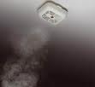
Residential Care
New Definitions
Construction Type
Design Criteria
Sprinklers
Smoke Alarms
Notes:
Finally we look at detection and alarm requirements

Slide 28
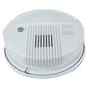
Smoke Detectors and Alarms
Permit use of smoke alarms within sleeping rooms
and suites of residential care in lieu of smoke detectors
Notes:
One of the relaxations permitted which provides a cost effective approach is by permitting the use of smoke alarms within sleeping rooms and suites of residential care in lieu of smoke detectors. This change does not eliminate the need to install a fire alarm system throughout the building as the common elements ie public corridors, stairwells, etc. will still require smoke detectors.
28

Slide 29
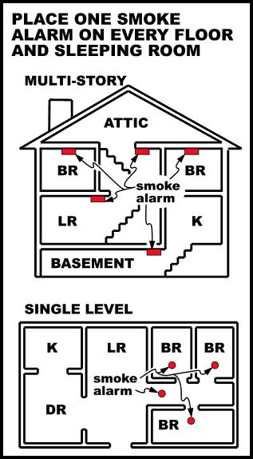
Smoke Alarms
Smoke alarm shall
  be installed in bedrooms
    Fires in sleeping rooms are second highest causes of fire deaths
Notes:
Statistics have shown that next to kitchen fires, fires originating in sleeping rooms within dwelling units account for the second highest causes of fire deaths in homes. With the current code requirement for smoke alarms to be located in corridors outside the sleeping rooms, this has caused a delay in notifying occupants in the sleeping rooms of a fire especially if the fire originates within that room with the door closed. This is for two reasons:
the audibility levels within the sleeping room may be reduced due to the closed door, and
secondly the smoke travel from the sleeping room to the detector (if door is closed) will be impeded thus delaying activation and early notification of occupants.
Smoke alarms located within the corridor will be still be required as they are better capable of detecting a fire originating outside of the room.

Slide 30
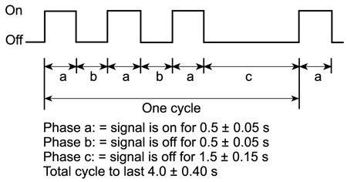
Smoke Alarms
Smoke alarm shall
  meet the temporal pattern or voice relay
    Improve audibility and early detection
Notes:
The requirement of a temporal pattern for smoke alarms that was introduced for residential occupancies has been expanded to include care occupancies.
Another provision has been introduced to improve the capacity of the alarm sound of the smoke alarm to be heard at night time. Studies have shown that a sound pattern respecting the temporal pattern is more probable to awake the elderly and very young occupants than standard alarm. Combine with the bedroom installation, this measure will improve the effectiveness of evacuation in the residential home.

Slide 31
Convalescent and Children’s Custodial Homes
Classified as residential occupancy within Part 3
Occupants must be
  ambulatory
  live in single housekeeping unit
Accommodation for not more than 10 persons
NEW
Notes:
Convalescent homes and children’s custodial homes are permitted to be classified as residential occupancies within the application of Part 3, provided that occupants are ambulatory and live as a single housekeeping unit in a suite with sleeping accommodation for not more than 10 persons.
This change provides clarification as to the application of convalescent and custodial homes within Part 3. Smaller buildings ( less than 600 metres squared) that fall within the category of residential based on these conditions must meet the residential requirements of Part 3.

Slide 32
Summary
New classification group B Div. 3 introduced
Various relaxations from current B2 requirements for
  Construction
  Corridor and door widths
  Sprinkler
  Fire alarm
Notes:
32

Slide 33
www.nationalcodes.ca
Questions?
Send them to us at codes@nrc-cnrc.gc.ca
Thank you!

