Slide 1

Radon
2010 NATIONAL MODEL CONSTRUCTION CODES
Frank Lohmann & Morched Zeghal
NRC Canadian Codes Centre
February 2011

Slide 2
Introduction
Presentation is part of a series on the 2010 National Model Construction Codes
Model codes developed by Canadian Commission on Building and Fire Codes
These codes must be adopted by provincial/territorial authorities to become law
Notes:
This Presentation is part of a series of 13
on the 2010 National Model Construction Codes.
It is important to note that the model codes, which are developed
by the Canadian Commission on Building and Fire Codes
must be adopted by provincial/territorial authorities to become law.
This may mean that code requirements enacted by legislation within
your province or territory might differ from what is presented here.
Please check with your local authority.

Slide 3
Key Messages
Technical changes for radon address:
  New Health Canada guideline
  for acceptable indoor concentration of radon
  Basic protection of all houses and buildings
  Specific provisions to address future radon mitigation
  in new housing and small buildings
Information for existing houses and buildings
  CMHC
  Health Canada
  EPA
Notes:
The presentation will relay two keys messages
Technical changes for radon. It includes an overview of
The New Health Canada guideline for acceptable indoor concentration of radon
Some measures offering a basic protection of all houses and buildings, and
Specific provisions to address future radon mitigation in new housing and small buildings
the presentation also includes information on radon for existing houses and buildings by organizations such as CMHC, Health Canada, EPA.

Slide 4
Outline
General information on radon
Development of proposed changes
Proposed changes
  Part 5
  Part 6
  Part 9
Notes:
Here is an outline of the presentation.
We will start with
some general information on radon and
the development of proposed changes
before presenting the details of the proposed changes for Part 5, Part 6 and Part 9 of the NBC.

Slide 5

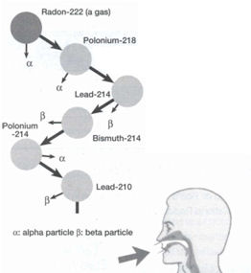
What is Radon?
  Radioactive gas, naturally occurring
  Produced by the decay of uranium
  During decay alpha particles are given off
  Inhalation of particles damages lungs
  Odorless
    Tasteless
      Colourless
Notes:
Radon is a naturally occurring radioactive gas that is produced by the decay of uranium-bearing minerals in rocks and soils.
During the decay, radioactive alpha particles are given off and these particles are responsible for the damage to our health.
Radon is
Odorless
Tasteless
Colorless

Slide 6
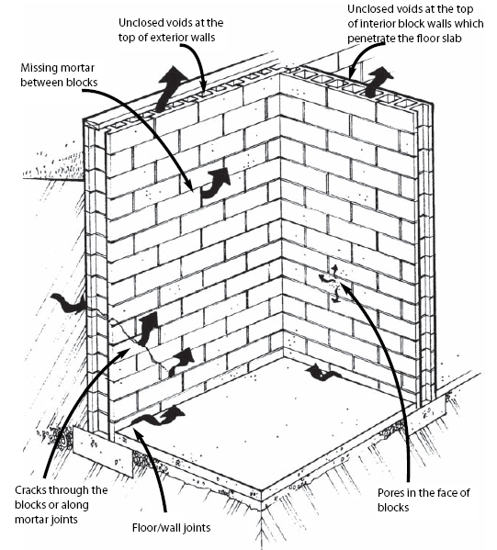
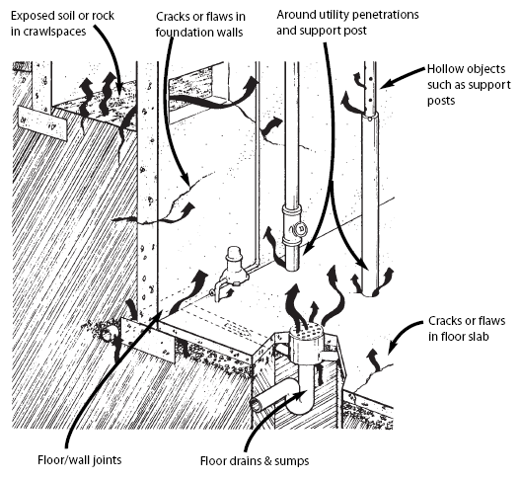
Where Does Radon Come From?
Illustration from: Radon - A Guide for Canadian Homeowners (CMHC –2007)
Notes:
Here is an illustration of some typical ingress paths for radon. They include
- cracks in walls,
open perimeters between slabs and walls
pipes
openings to unprotected soil
unsealed cavities in masonry blocks
unsealed floor drains

Slide 7
Why Should We Pay Attention?
  Health Canada estimates 1,900 lung cancer deaths
  per year are related to radon
  We spend more time indoors,
  including basements
  Tighter buildings
  Some geographical areas
  are known for high risk
  of radon in the ground
  Health Canada reduced
  the permissible Canadian Action Level from 800 Bq/m³ to 200 Bq/m³
cosmic radiation
radon inhalation
external terrestrial
ingestion
Average worldwide exposure
to radiation sources
Notes:
Many facts oblige us to pay attention to radon:
As you can see in the graph, radon inhalation represents more than 50% of our exposure to this gas which is causing some health problems. In fact, Health Canada estimates that 1,900 lung cancer deaths per year are related to radon
We spend more time indoors, including basements
We construct tighter and tighter buildings , and
Some geographical areas are known for high risk of radon in the ground
As a results of these health related findings and Canadians’ new ways of constructing and living, Health Canada made the Canadian guideline on radon more stringent.

Slide 8
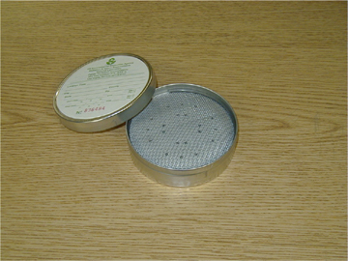
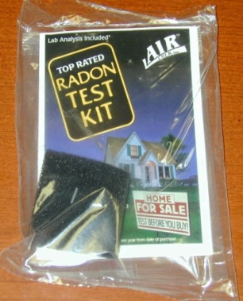
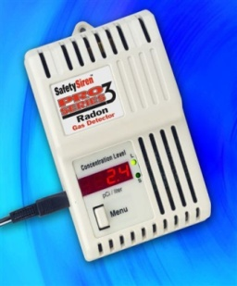
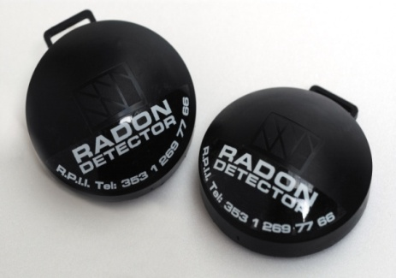
How can Radon be Measured?
Health Canada – radon test
  Minimum 1 month during heating season
  Average annual limit ≤ 200 Bq/m³
Testing for codes …
  not possible during construction
  not enforceable at time of construction
  not practical/economical for builders
Responsibility to test
  … rests with the owner
Notes:
How is radon measured?
Health Canada recommends
performing radon tests during the heating season for a minimum period of 1 month, and
taking action when the average annual concentration is higher than 200 Bq/m³
Testing for radon from the codes perspective is
Not possible during construction
And is therefore also not enforceable at the time of construction
Testing even if done after construction is complete is also not practical/economical for builders
And as such the responsibility to test for radon rests with the building owner.

Slide 9
Task Group on Radon
Mandate
  Validate/review current requirements
    Is protection by current construction adequate
      … for 800 Bq/m³?
      … for 200 Bq/m³?
    What can be done to make current requirements more effective?
  Develop changes on means of protection from radon ingress
  Do not consider
    Diffusion of radon through materials – small contributor
    Soil testing pre-construction – no correlation to indoor concentration
    Radon emanation from building materials – small contributor
Notes:
The Standing Committees on Environmental Separation and Housing and Small Building put together a Joint Task Group on Radon. It had the mandate to
Validate/review current requirements in an effort to answers the questions
Is protection by current construction adequate in terms of the old guideline (800 Bq/m³) and the new guideline (200 Bq/m³)? and
What can be done to make current requirements more effective?
The JTG was mandated with developing changes for protection from radon ingress.
However, the Task Group decided not to consider
Diffusion of radon through materials as it is a small contributor
Soil testing prior to construction as there is no clear correlation to indoor concentration
Radon emanation from building materials as it is a small contributor.

Slide 10
Task Group on Radon
Mini-data collection in high-risk areas
  3 high-risk locations tested in BC, MB, NS
  90+ newly constructed houses
  Testing for 6 weeks in March/April 2008
Two locations (60+ houses)
  Current practice:
    Sealing perimeter and penetrations as well as specific inspections NOT common practice
  Results:
    Increased levels of radon, many above 800 Bq/m³
Notes:
To answer some of the questions, the Task Group undertook a study that consisted of collecting radon related data in high risk areas.
Three high risk areas in BC, MB and NS were considered. The study included more than 90 newly constructed houses and the testing was performed for 6 weeks in the heating season of March/April 2008
Here are some details of the study:
In two locations, constituting more than 60 houses, sealing perimeter and penetrations as well as specific inspections were NOT common practice.
In these houses, testing showed increased levels of radon with many even above the old guideline of 800 Bq/m³.

Slide 11
Task Group on Radon
One location (29 houses)
  Current practice:
    Sealing perimeter and penetrations by builders required
    Inspections by officials common
  Results:
    Acceptable levels of radon (current guideline)
    50% of houses were within new guideline of 200 Bq/m³
    Houses over 200 Bq/m³ had issues in the inspection protocol
Conclusion
  Current code provisions, when applied and inspected,
  provide acceptable basic protection
Notes:
In the other location, constituting 29 houses, current construction practice required the sealing of the perimeter and the penetrations and it also required inspections by officials.
Testing of these houses showed
- in all cases - Acceptable levels of radon vis-avis the old guideline of 800 Bq/m³
- in 50% of all cases – that houses were within the new guideline of 200 Bq/m³, and
- for those houses that were above the 200 Bq/m³ that issues were identified in the inspection protocol.
The Task Group therefore concluded that current code provisions, when applied and inspected, provide acceptable basic protection.

Slide 12
Radon in the 1995/2005 NBC
Large buildings (design requirements) – 2005 NBC
  … as a system
  Air barrier systems (Part 5)
  Drainage & waterproofing (Part 5)
  Ventilation systems (Part 6)
  Air contaminants (Part 6)
  Excavation (Part 4)
Specifically on radon:
  One sentence in Appendix Note in Part 5
Notes:
Before presenting the changes, let me explain how the radon requirements looked in the 1995/2005 NBC.
For large buildings, design requirements are dealt with as a system in terms of basic requirements covering
Air Barrier Systems
Drainage & Waterproofing
Ventilation Systems
Air Contaminants
Excavation
In terms of specific requirements, radon was only mentioned in one sentence in an appendix note in Part 5.

Slide 13
Radon in the 1995/2005 NBC
Part 5 – 2005 NBC
Control of Air Leakage (performance targets)
  … provide & maintain acceptable conditions
  … minimize condensation and precipitation ingress
  … avoid ice damming
  … not compromise operation of building services
Appendix Note
  An air barrier system may be required in components and assemblies in contact with the ground to control the transfer of soil gases such as radon and methane
Notes:
Let’s take a closer look at the requirements included in Part 5 of the 2005 NBC.
The section in Part 5 that deals with the control of air leakage provided the following performance targets
provide & maintain acceptable conditions
minimize condensation & precipitation ingress
avoid ice damming
not compromise operation of building services
And the appendix note stated that
” An air barrier system may be required in components and assemblies in contact with the ground to control the transfer of soil gases such as radon and methane”

Slide 14
Code Changes
Part 5 – 2010 NBC
Control of Air Leakage (performance targets)
  … provide & maintain acceptable conditions
  … minimize condensation & precipitation ingress
  … avoid ice damming
  … not compromise operation of building services
  Minimize the ingress of airborne radon from the ground with an aim to controlling the indoor radon concentration to an acceptable level
Notes:
The change in the body of Part 5 of the NBC, introduces a performance target specific to radon that you see in blue and
it states
“ Minimize the ingress of airborne radon from the ground with an aim to controlling the indoor radon concentration to an acceptable level”

Slide 15
Code Changes
Part 5 – 2010 NBC
Appendix Note
  …
  In addition to an air barrier system, other measures may be required to reduce the radon concentration to a level below the guideline specified
  by Health Canada
  Further information on protection from radon ingress can be found in:
    “Radon: A Guide for Canadian Homeowners” (CMHC/HC)
    “Guide for Radon Measurements in Public Buildings (Schools, Hospitals, Care Facilities, Detention Centres)” (HC)
    EPA/625/R-92/016, “Radon Prevention in the Design and Construction of Schools and Other Large Buildings”
Notes:
The change in Part 5 also include modifying an appendix note to draw the attention that other measures in addition to an barrier system may be required to lower radon concentration to a level below the new guidelines specified by Health Canada (200 Bq/m³).
The appendix note also lists three documents published by Canada Mortgage and Housing Corporation, Health Canada and Environmental Protection Agency for further information on radon ingress.

Slide 16
Radon in the 1995/2005 NBC
Part 6 – 2005 NBC
Good Engineering Practice
  Heating, ventilating and air-conditioning systems, including mechanical refrigeration equipment, shall be designed, constructed and installed in conformance with good engineering practice:
    ASHRAE Handbooks and Standards, HRAI Digest, Hydronics Institute Manuals, NFPA Standards, SMACNA Manuals, Industrial Ventilation Manual published by the ACGIH, CSA-B214,Hydronic Heating Systems, CSA-Z317.2, HVAC Systems in Health Care Facilities
Notes:
Part 6 of the 2005 NBC, has a list of good engineering practice documents related to heating, ventilation and air-conditioning systems.

Slide 17
Code Changes
Part 6 – 2010 NBC
Good Engineering Practice
  Heating, ventilating and air-conditioning systems, including mechanical refrigeration equipment, shall be designed, constructed and installed in conformance with good engineering practice:
    … and, EPA/625/R-92/016, “Radon Prevention in the Design and Construction of Schools and Other Large Buildings”
Notes:
The change in Part 6 and included in the 2010 NBC adds a radon-related guidance document to the list of good engineering practice documents.
The document is from the EPA – the Environmental Protection Agency in the US and contains design information for schools and other large buildings.

Slide 18
Code Changes
Part 6 – 2010 NBC
New Appendix Note
…
Radon Control
  Measures may be necessary to reduce the radon concentration to a level below the guideline specified by Health Canada
  Further information on reducing the indoor concentration of radon can be found in the following Health Canada publications:
    “Guide for Radon Measurements in Public Buildings (Schools, Hospitals, Care Facilities, Detention Centres)”
    “Radon: A Guide for Canadian Homeowners (CMHC/HC)
Notes:
The change in Part 6 appendix note is similar to the one included in the appendix note of Part 5.
It
draws the attention to measures that may be required to lower radon concentration to a level below the new guidelines of 200 Bq/m³ specified by Health Canada
and it
lists two documents published by Canada Mortgage and Housing Corporation and health Canada for further information on radon ingress.

Slide 19
Radon in the 1995/2005 NBC
Housing and small buildings (prescriptive) – 2005 NBC
… as a system:
  Excavation (9.12.)
  Foundation wall and floor material (concrete) (9.3.)
  Floors-on-ground (9.16.)
  Dampproofing (9.13.)
  Air barrier systems (9.25.)
  Ventilation (9.32.)
Specifically:
  Protection from all soil gases including radon
  was addressed in Subsection 9.13.4.
Notes:
Let me know focus on housing and small building. These types of buildings are addressed in Part 9 of the NBC using prescriptive provisions.
Similar to the large building parts, radon in the 2005 NBC Part 9 is dealt with as a system in terms of basic requirements covering
Excavation
Foundation wall and floor material (concrete)
Floors-on-ground
Dampproofing
Air barrier systems
Ventilation
In terms of specific requirements, radon is addressed in its own subsection 9.13.4. dealing with the protection from soil gases.

Slide 20
Radon in the 1995/2005 NBC
Part 9 – Basic Protection – 2005 NBC
Applies to all housing and small buildings:
  Air barrier requirements in 9.13.
    For below-ground walls
    Slab perimeter sealed to air barrier of wall
    All penetrations (mostly pipes) sealed
  Sump pit cover required (9.14.)
  Requirements for ground cover (9.18.)
  Exemption from fill under slab (9.16.)
Notes:
The basic protection in Part 9 of the 2005 NBC applied to all housing and small buildings and included
Air barrier provisions for below-ground walls which require the
Slab perimeter to be sealed to the air barrier of the wall
All penetrations (mostly pipes) sealed
Part 9 required
a sump pit cover
A ground cover in crawl spaces
and it allowed an exemption from the fill under the slab

Slide 21
Radon in the 1995/2005 NBC
Part 9 – Basic Protection – 2005 NBC
  Air-seal floor drains
Illustration from: Radon - A Guide for Canadian Homeowners (CMHC –2007)
Notes:
Here are now some figures illustrating how to air-seal floor drains

Slide 22
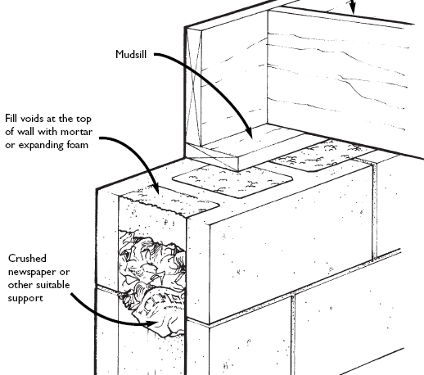
Radon in the 1995/2005 NBC
Part 9 – Basic Protection – 2005 NBC
  Air-seal hollow masonry
Illustration from: Radon - A Guide for Canadian Homeowners (CMHC –2007)
Notes:
How to air seal hollow masonry

Slide 23
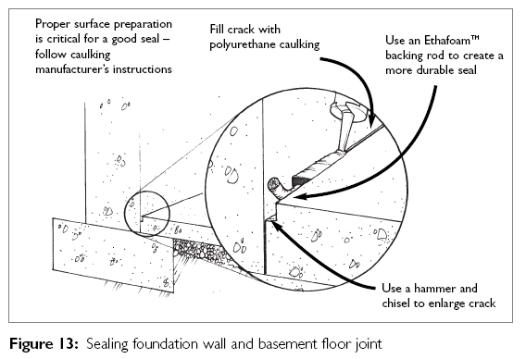
Radon in the 1995/2005 NBC
Part 9 – Basic Protection – 2005 NBC
  Seal slab perimeter
Illustration from: Radon - A Guide for Canadian Homeowners (CMHC –2007)
Notes:
and how to seal slab perimeter
All these were already required and they are still required just in a different location of Part 9.

Slide 24
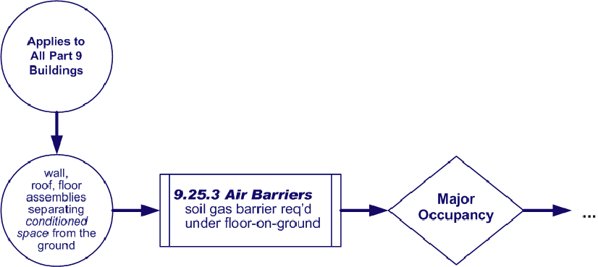
Code Changes
Part 9 – Application – 2010 NBC
  Address Soil Gas Protection
Notes:
In order to explain the 2010 changes in their context, I will go through them in form of a decision flow chart.
First of all the requirements apply to all Part 9 buildings.
They address the protection from all soil gases – not just radon and they deal with the construction of walls, roofs, floor assemblies that separate conditioned space from the ground.
These requirements are located in the section in Part 9 that deals with air barrier systems – which is Section 9.25.
A key requirement here is that a soil gas barrier from strong polyethylene is required in all Part 9 buildings
From here on, all requirements are
Specific to radon
and are occupancy dependent – which means that we are dealing with residential and non-residential occupancies separately.

Slide 25
Code Changes
Part 9 – Basic Protection – 2010 NBC
Applies to all housing and small buildings:
  Air barrier requirements moved from 9.13. to 9.25.
    For below-ground walls
    Polyethylene soil gas barrier required under slab
    Slab perimeter sealed to air barrier of the wall
    All penetrations (mostly pipes) sealed
  Sump pit cover required to be airtight (9.14.)
  Consistent requirements for ground cover (9.18.)
  Exemption from fill under slab deleted (9.16.)
Notes:
Here are some of the changes to the basic protection in a little more detail:
The air barrier requirements are moved to a more relevant section
A polyethylene soil gas barrier is not optional anymore now required under slabs for all buildings
Sump pit covers are now required to be airtight
The requirements for ground cover are more consistent
The exemption from fill under slab was deleted because it was incorrect

Slide 26
Code Changes
Part 9 – Basic Protection – 2010 NBC
  Airtight sump pit covers
Illustration from: Radon - A Guide for Canadian Homeowners (CMHC –2007)
Notes:
Here is a figure illustrating how to make sump pit covers airtight.

Slide 27
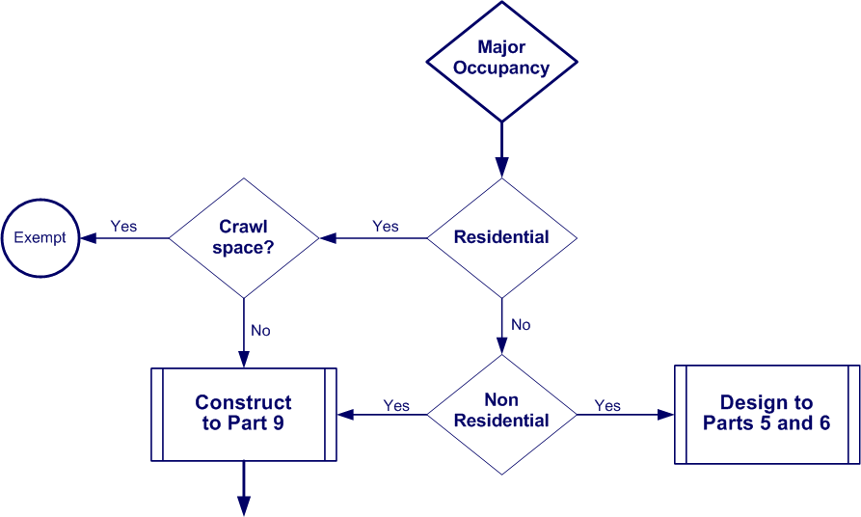
Code Changes
Part 9 – Application – 2010 NBC
  Radon Protection
Notes:
We left the last flow chart saying that all specific radon requirements are dealt with based on Major Occupancy
Residential Occupancy
For residential occupation
Crawl Space?
Most buildings with a crawl space are exempted from radon requirements
unheated crawl spaces are exempted because they do not separate conditioned space from the ground
heated crawl spaces are only exempted if they do not include a concrete floor on ground and remain accessible for the future installation of a radon mitigation system
Buildings without such crawl spaces need to be constructed according to the requirements in the remainder of this Section in Part 9
For Non-Residential Occupancy
For non-residential occupation a builder has the choice between constructing to Part 9 or designing to Parts 5 and 6.
There is also an Exception for Non-residential Buildings that are Occupied for only a Few Hours a Day.
Health Canada established the guideline for radon for buildings that are occupied by persons for more than 4 hours per day.
This exception in Part 9 allows therefore buildings not occupied for 4 hours some relaxation.

Slide 28
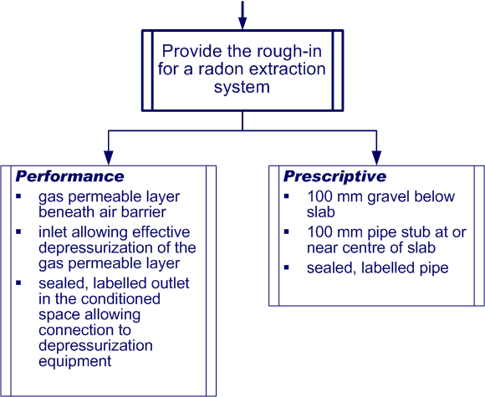
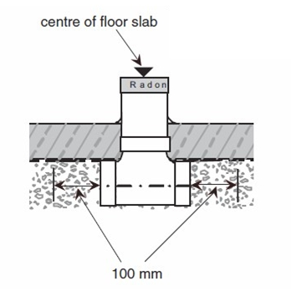
Code Changes
Part 9 – Rough-in – 2010 NBC
gas permeable layer beneath air barrier
inlet allowing effective depressurization of the gas permeable layer
sealed, labelled outlet
in the conditioned
space allowing connection to depressurization equipment
Notes:
Let me go back to the provisions in Part 9 that require a rough in for a radon extraction system,
There are two sets of requirements
1 a prescriptive set
2 a performance-based set of requirements
The builder has a choice whether to follow prescriptive or performance requirements.
The prescriptive requirements call for a layer of 100 mm gravel below the slab and a 100 mm diameter pipe stub placed at or near the centre of the slab that needs to be sealed and labelled.
The illustration on the right describes one possibility for such as setup.
The performance path leaves it a little bit more open as to how the building is designed and constructed for the future mitigation of radon.
The performance provisions require:
a gas permeable layer beneath the air barrier – this could be a dimpled membrane or a network of drainage pipe
an inlet – connected to the gas permeable layer that allows effective depressurization of that layer – some kind of a pipe or duct is probably the best solution here too.
It also requires, like the prescriptive path
- a sealed and labelled outlet in the living space that allows a future connection to ventilation equipment.

Slide 29
Radon in the 1995/2005 NBC
Part 9 – Specific Provisions – 2005 NBC
  Exemption
    Where it can be demonstrated that radon is not a problem
  Article 9.13.4.6. Subfloor Depressurization
  – as an option for dwelling units only
    Granular fill under slab
    Capped, labeled pipe
    Bottom end located near centre of slab
    Top end ready for active system
    Testing required
    Activating of system required on exceeding limit
  Polyethylene under slab
  – as an option for dwelling units
  – required for all other buildings
Notes:
Here is another look at the specific changes in Part 9.
In the 2005 NBC:
an exemption was based on demonstrating that radon is not a problem in a certain location
Subfloor Depressurization was an option for dwelling units only.
It consisted of the following requirements:
Granular fill under slab
Capped, labeled pipe
Bottom end located near centre of slab
Top end ready for active system
Testing required
Activating of system required on exceeding limit
Polyethylene under the slab required for all buildings that did not use the exemption or the subfloor depressurization system

Slide 30
Code Changes
Part 9 – Specific Provisions – 2010 NBC
  Exemption
    Where it can be demonstrated that radon is not a problem
  Article 9.13.4.6. Subfloor Depressurization
  – as an option for dwelling units only
    Granular fill under slab
    Capped, labeled pipe
    Bottom end located near centre of slab
    Top end ready for active system
    Testing required
    Activating of system required on exceeding limit
  Polyethylene under slab
  – as an option for dwelling units
  – required for all other buildings
Notes:
In a nutshell, the changes to the Part 9 specific provisions will
Delete the exemption because such a demonstration is very difficult – if not impossible to undertake – especially before construction
Make the basic setup for subfloor depressurization mandatory
But delete radon testing and
delete the requirements to activate the system on exceeding limit

Slide 31
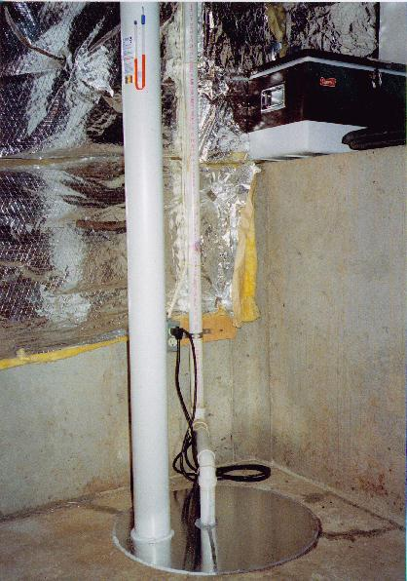
Code Changes
Part 9 – Specific Provisions – 2010 NBC
  Exemption
    Unheated crawl spaces
    Accessible heated crawl spaces without slab
  Rough-in for subfloor depressurization
    Deemed-to-comply prescriptive solution
      Granular fill under slab
      Capped, labeled pipe
      Bottom end located near centre of slab
      Top end ready for active system
    Performance solution
      Can be used for structural slabs, innovative radon systems, other fills
Notes:
In 2010, the Part 9 specific provisions look like this
unheated crawl space are exempted and accessible heated crawl spaces without slab as well
And the requirements introduce a performance solution that can be used in otherwise difficult situations for instance under structural slabs or for innovative radon systems and other fills.

Slide 32
Code Changes
Other Changes to Part 9 (Radon) – 2010 NBC
  Updated various Appendix Notes
  Protection from depressurization
    Deleted radon as a trigger for make-up air
    Exempted radon fans from being counted as exhaust devices
  Risk of freezing foundations
    Moved from code into Appendix
Notes:
For the 2010 changes in Part 9
various Appendix Notes were updated
radon was deleted as a trigger for requirements for make-up air
And a sentence that required to consider the risk of freezing foundations when radon systems are installed was moved from the body of the Code into an appendix note

Slide 33
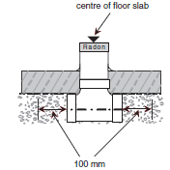
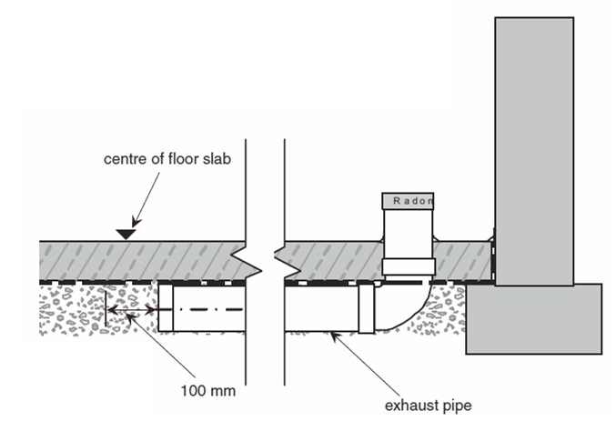
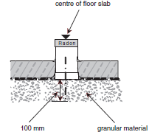
Code Changes
Other Changes to Part 9 (Radon) – 2010 NBC
  New Appendix Notes and Illustrations
Notes:
Here is a look at some of the illustration included in new appendix notes.
The figures show various acceptable scenarios for the extraction opening

Slide 34
Summary
Radon is a health risk
  Health Canada establishes that risk
Buildings work as a system
  Basic protection (soil gas)
  Specific provisions (radon)
NBC requirements
  For housing and small buildings
  Large buildings
NBC applies to new construction only
CMHC, HC, EPA provide guidance for existing buildings
Effective solutions are available
Notes:
Here is a summary of what was covered in this presentation:
Health Canada establishes that radon is a health risk and what the acceptable concentration is
Radon is addressed by looking at the buildings as a system in terms of basic protection against soil gases and in terms of requirements specific to radon
NBC requirements/changes now cover large buildings as well as housing and small buildings.
It is important to note that the NBC applies only to new construction
But that Canada Mortgage and Housing Corporation, Health Canada and Environmental Protection Agency provide guidance for existing buildings
Most importantly you should remember that effective solutions are available to address radon and that the building code requirements make a future radon systems easier to integrate.

Slide 35
More on Radon …
CMHC Guide
http://www.cmhc-schl.gc.ca/odpub/pdf/61945.pdf
Health Canada - Environmental and Workplace Health http://www.hc-sc.gc.ca/ewh-semt/radiation/radon/index-eng.php
U.S. Environmental Protection Agency
http://www.epa.gov/radon
Notes:
More information on radon can be found on the websites of Canada Mortgage and Housing Corporation, Health Canada and the US Environmental Protection Agency.

Slide 36
www.nationalcodes.ca
Questions?
Send them to us at codes@nrc-cnrc.gc.ca
Thank you!

