Slide 1

Windows, Doors,
Skylights and Sealants
2010 NATIONAL MODEL CONSTRUCTION CODES
Frank Lohmann & Morched Zeghal
NRC Canadian Codes Centre
February 2011
Notes:
This presentation is about changes related to windows, doors and skylights as well as sealants.
Both subjects are dealt with in Part 5 and in Part 9 of the National Building Code of Canada 2010.

Slide 2
Introduction
Presentation is part of a series on the 2010 National Model Construction Codes
Model codes developed by Canadian Commission on Building and Fire Codes
These codes must be adopted by provincial/territorial authorities to become law
Notes:
This Presentation is part of a series of 13
on the 2010 National Model Construction Codes.
It is important to note that the model codes, which are developed
by the Canadian Commission on Building and Fire Codes
must be adopted by provincial/territorial authorities to become law.
This may mean that code requirements enacted by legislation within
your province or territory might differ from what is presented here.
Please check with your local authority.

Slide 3
Key Messages
Technical changes for windows, doors and skylights address:
  Referencing a harmonized North American Fenestration
  Standard (NAFS)
  Adding Subsection 5.10.2. and restructuring Sections 9.6. and 9.7.
  Identifying performance targets in Part 9
  Identifying quantitative minimum thermal characteristics in Part 9
Technical changes for sealants address:
  Referencing up-to-date standards for sealant products
  Relevant and new sealant product categories
  A standard for backer rods
Notes:
The code changes related to windows, doors and skylights address
- the reference to the harmonized North American Fenestration Standard (NAFS)
a new Subsection 5.10.2.
the restructuring Sections 9.6. and 9.7.
We will talk a little bit about new performance requirements in Part 9
… and new thermal requirements for windows, doors and skylights in Part 9.
Technical changes for sealants address
- references to up-to-date standards for sealant products
a few new sealant product categories
the addition of a standard reference for backer rods.

Slide 4
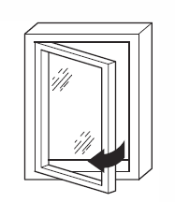
Windows, Doors and Skylights
Standards and code requirements
  AAMA/WDMA/CSA 101/I.S.2/A440
  NAFS – North American Fenestration Standard
  Specification for Windows, Doors, and Skylights - 2008
    US-only requirements
    Canada-only requirements
  CSA A440S1 Canadian Supplement
    Snow loads
    Air leakage
    Marking (secondary designator)
    Insect screens
  Subsection 5.10.2.
  Section 9.7
Notes:
Because the harmonized standard is key to these changes, I would like to spend a few minutes on explaining the new standard.
The full name of the standards is
AAMA/WDMA/CSA 101/I.S.2/A440 NAFS – North American Fenestration Standard Specification for Windows, Doors, and Skylights.
Throughout this presentation I will refer to it as Harmonized Standard.
The harmonized standard includes
some US-only requirements in the NAFS
and some Canada-only requirements in the NAFS (climate, air leakage, etc).
Then there is the Canadian supplement, a separate CSA standards:
it contains specific Canadian requirements on load calculation
consistent with part 4,
requirement for labeling, for air leakage, and one specific test for insect-screens holding force.
Subsection 5.10.2. and Section 9.7. reference these two standards and have a few more requirements in addition to the standards.

Slide 5
Harmonized Standard
Compare old fenestration standards
with NAFS 2008
  Ensure same level of performance
  Replace 5 standards
    CSA A440-2000
    CSA A440.2 User Selection Guide
    CGSB 63.14 Plastic Skylights
    CSA 82.1 Sliding Doors
    CSA 82.5 Insulated Steel Doors
  with NAFS-2008 & Canadian Supplement
    AAMA/WDMA/CSA 101/I.S.2/A440
    CSA A440S1
Notes:
The reason the Harmonized Standard and the Canadian Supplement are referenced is to replace a number of outdated standards.
The Windows standard A440 was the most up-to-date and the NAFS is being published under the A440 banner in Canada.
The other replaced standards are
CGSB 63.14 Plastic Skylights
CSA 82.1 Sliding Doors
CSA 82.5 Insulated Steel Doors.
The work of comparing these old standards to the NAFS was done by a Joint Task Group between Part 9 and Part 5.
This Task Group developed proposed changes and tried to ensure that the new standards required windows, doors and skylights to perform at the same level.

Slide 6
Harmonized Standard – Equivalency
Compare old fenestration standards
with NAFS 2008
  Key similarities
    Uses same test procedures
    Canadian material standards are included
    Similar auxiliary tests (optional)
  Key differences
    Different rating presentation
    5 performance classes & maximum test size
    More fenestration styles or types + skylights, glass
    doors, entry doors, tubular daylighting devices
Notes:
Here is a look at the key similarities and key differences.
Key similarities
- the NAFS standard
Uses same test procedures
Lists similar auxiliary tests
Includes many Canadian material standards
Key differences between the old and new standard are:
- It uses a different rating presentation than what Canadian industry is used to with the ABC ratings
NAFS uses 5 performance classes & minimum test size – this is a new concept
NAFS lists more fenestration and door styles and types + skylights
as well as tubular daylighting devices [show on slide]

Slide 7
Harmonized Standard – Marking
Class R PG1200: Size tested 760 × 1250 mm – Casement
  Class R
    Indicates performance class
    R is minimum (NBC requirement)
  PG 1200
    Indicates performance grade
    Tested and passed at 1200 Pa design pressure
  Size tested 760 x 1250 mm
    Indicates maximum product size tested
  Casement
    Indicates product type
Class R PG1200: Size tested 760 × 1520 mm - Casement
Positive Design Pressure (DP) = 2400 Pa
Negative Design Pressure (DP) = –2880 Pa
Water Penetration Resistance Test Pressure = 180 Pa
Canadian Air Infiltration/Exfiltration = A3 Level
Notes:
Up here you can see what’s called a “primary designator”
This information should be available for each window sold.
In Canada there is a requirement for this to be affixed to a window when shipped.
Here is what the numbers on the primary designator mean.
Class R
The NBC requires the “R” class as the minimum performance class for all windows, doors and skylights, although there are other performance classes.
PG 1200
This Indicates Performance Grade – and means that the product has passed all tests based on a 1200 Pa design pressure.
– a table in the standard gives more information as to which tests have been passed and at what the actual test pressure levels were.
Size tested 760 x 1250 mm
This Indicates the maximum product size that was tested - larger products may not perform the same at the loads for which this product was tested.
Casement
This indicates product type – in this case a casement window.
Down here a secondary designator is displayed.
A secondary designator is required by the Canadian Supplement.
It gives additional information on test pressures and air leakage levels.
This information can be important when selecting an appropriate fenestration product for a specific location.
The second designator is also required to be shown on the label that is affixed to the window when shipped.

Slide 8
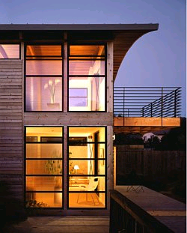
NBC Part 5
5.10.2. Windows, Doors & Skylights (new)
5.10.2.1. Application
  Windows, doors and skylights
  Separating interior space from
    exterior space or
    environmentally dissimilar interior spaces
  “Skylights” = unit skylights, roof windows and
  tubular daylighting devices
5.10.2.2. Applicable Standards
5.10.2.3. Structural Loads, Air Leakage
and Water Penetration Compliance
5.10.2.4. Heat Transfer Compliance
Notes:
Now let’s have a look at the new code requirements.
Let’s start in Part 5.
See the table of contents for these requirements here.
We will talk about these articles in a little bit more detail.
Article 5.10.2.1. contains some general provisions up front saying that
this subsection applies to windows, doors and skylights
separating interior space from exterior space or environmentally dissimilar interior spaces.
It also contains
a definition clarifying that unit skylights, roof windows and tubular daylighting devices are all covered under the name “skylight”.
Article 5.10.2.2. contains the references to the Standards.
Article 5.10.2.3. contains requirements on applicable Loads.
Article 5.10.2.4 contains performance requirements for Heat Transfer.

Slide 9
Standards & Compliance
5.10.2.2. Windows, doors and skylights covered in NAFS
  Reference NAFS and Canadian Supplement
  Selection of performance grade
    According to Canadian Supplement
    Appropriate for the conditions and geographic location
  Selection of fenestration product
    Meeting required performance grade
    When tested in accordance with the NAFS
5.10.2.3 … not covered in NAFS
  Article 5.1.4.1. (Structural and Environmental Loads)
  Sections 5.4. (Air Leakage) and 5.6. (Precipitation)
Notes:
Here is a more detailed look at Article 5.10.2.2.
It lists NAFS and the Canadian Supplement, and the procedure for compliance.
This Article applies only to fenestration products covered in the scope of those documents.
It requires to
Select the required performance grade for the geographic location and the climatic condition from the Canadian supplement
2) And then to make sure that the selected product conforms to the necessary performance grade when tested to the Harmonized Standard.
Article 5.10.2.3. then deals with fenestration products not covered in the scope of the harmonized standard.
These could be site-built products, but also includes window walls and curtain walls.
For these products, Part 5 requires compliance with the general performance requirements on structural loads, air leakage and water penetration.

Slide 10
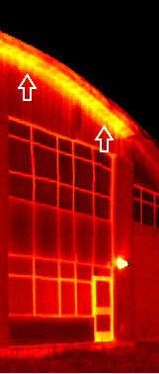
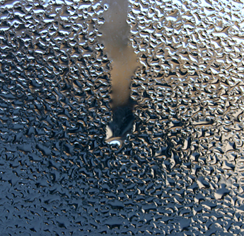
5.10.2.4 Heat Transfer Compliance
Heat transfer (moved existing requirements)
  Metal frames require a thermal break
  to minimize condensation
Thermal breaks are NOT required in
  storm windows or doors, or
  windows or doors required to have a fire
  protection rating
Notes:
Article 5.10.2.4. contains
more prescriptive thermal requirements for windows, and
points to the heat transfer Section of Part 5, Section 5.3.
These are all existing requirements or exemptions on thermal breaks and minimum glazing that have just been moved.

Slide 11
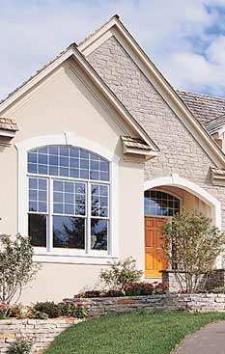
NBC Part 9
Overview Part 9 changes
  Section 9.7. Windows, Doors, Skylights
  Section 9.6. Glass Doors
  Moved area & design, guard, egress requirements
  into Section 9.5., 9.8. and 9.9.
  CSA A440.4 Installation Standard referenced
  Replaced 5 standards with NAFS-2008
Notes:
Here is the overview of what the Part 9 changes address:
Essentially the changes in Part 9 have forced the creation of
- A New Section 9.7. Windows, Doors, Skylights and
- A New Section 9.6. on Glass.
Requirements on areas and design as well as for guards and some egress requirements have been moved into Section 9.5., 9.8. and 9.9.
where similar subject matters are already addressed.
CSA A440.4 - a new installation standard is now referenced.
And – as previously noted – the harmonized standard replaced 5 existing standards.
For ease of recognizing what’s new, we have put the changes or new text in blue underlined.

Slide 12
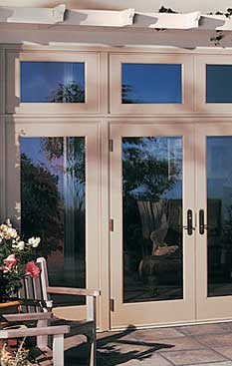
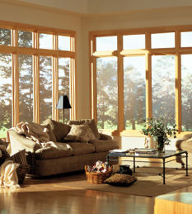
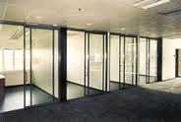
9.6. Glass
Section 9.6. applies to glass in:
  Interior doors and interior windows and their sidelights
  Clothes closets
  Site-built exterior windows, doors and skylights
  Shower or bathtub enclosures
  Glazed panels and partitions
No new requirements, just reorganized
Requirements deal with:
  Glass material standards
  Structural design of glass
  Protection of glass
Notes:
This is an overview of the requirements that are now located in Section 9.6.
Section 9.6 now applies to glass in the following components
Interior doors and interior windows and their sidelights
Clothes closets
Site-built exterior windows, doors and skylights
Shower or bathtub enclosures
Glazed panels and partitions
As you can see, they comprise components that are not addressed by NAFS.
You are likely familiar with the requirements in this Section; they address
Acceptable glass material standards
The structural design of glass
And the protection of glass
There is nothing new in these requirements; they have simply been moved into this Section.

Slide 13
9.7. Windows, Doors and Skylights
Organization of Section 9.7.
Notes:
This is a schematic showing
What Section 9.7 addresses
But also how the compliance path works.
You can see that section 9.7 has some typical elements.
But you can also see that the org-chart splits at one point
between manufactured products (they are dealt with in Subsection 9.7.4.)
and site-built products (they are dealt with in Subsection 9.7.5.)
But then ends with the installation subsection that applies to both categories of fenestration products.

Slide 14
9.7.1. General
Application, scope and entrance doors
  Windows, doors and skylights
    Separating conditioned space from unconditioned space
    Including main entrance doors
Clarifications that
  “Doors” include glazing in doors and sidelites for doors
  “Skylight” means unit skylights, roof windows and tubular daylighting devices
Notes:
Let’s start with Subsection 9.7.1.
It contains the application, the scope and some clarifications.
The requirements in Section 9.7. apply to
windows, doors and skylights separating conditioned space from unconditioned space
as well as entrance doors.
There are two provisions in this Section clarifying that
“Doors” include glazing in doors and sidelites for doors (this would also apply for transoms)
“Skylight” means unit skylights, roof windows and tubular daylighting devices.

Slide 15
9.7.2. General Requirements
Entrance doors
  An entrance door is required for each dwelling unit
  Requirements also include suite entry doors
  that do not separate inside from outside
  Entrance doors need a door viewer or transparent glazing
Other requirements for windows, doors and skylights
  Minimum size of doorways and doors 9.5.
  Guards, fall prevention 9.8.
  Egress & windows and doors within exits 9.9.
  Firefighting, spread of fire, flame spread 9.10.
  Non-heating season ventilation 9.32.
Notes:
Subsection 9.7.2. contains some general requirements for entrance doors and lists all other requirements for windows, doors and skylights that are provided elsewhere in the code.
Entrance doors are required for each dwelling unit
Requirements for entrance doors also includes suite entry doors that do not separate inside from outside
Entrance doors need a door viewer or transparent glazing
Article 9.7.2.2. is new.
It lists many other requirements for windows, doors and skylights that are not provided in this Section but that may apply to windows, doors or skylights.
For example it says that
Minimum size of doorways and doors can be found in section 9.5.
Requirements for windows with guards and on fall prevention in 9.8.
Egress and windows and doors within exits in 9.9.
Firefighting in 9.10. and ventilation in 9.32.
All these requirements are existing requirements, but the fact that we are listing them all in the code text is something new.

Slide 16
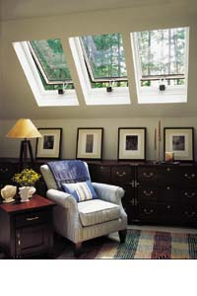
9.7.3. General Performance
Design and construction of exterior windows,
doors and skylights in closed positions shall:
  Resist ingress of precipitation into interior space
  Resist wind loads
  Control air leakage
  Resist ingress of insects and vermin
  Where required, resist forced entry
  Be easily operable
Skylights shall:
  … resist snow load
Notes:
Subsection 9.7.3 deals with the general performance expectation we have for windows, doors and skylights.
The performance expectations deal mainly with air, water and structural loads.
The performance requirements apply equally to manufactured and site-built fenestration products.
We expect that exterior windows, doors and skylights shall:
Resist ingress of precipitation
Resist wind and snow load
Control air leakage
Resist ingress of insects and vermin
Where required, resist forced entry
Be easily operable.
Skylights shall … resist snow load.

Slide 17
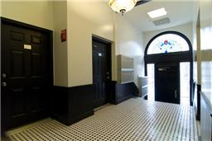
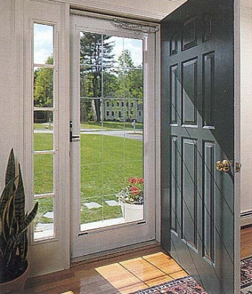
9.7.3. General Performance
Main entrance doors shall:
  Control air leakage
  Resist ingress of insects and vermin
  Resist forced entry
  Be easily operable
Storm doors shall:
  Resist wind loads
  Control air leakage (min. 5 m³/h to max 8.35 m³/h)
  Resist ingress of insects and vermin
  Be easily operable
Notes:
There are separate performance requirements for main entrance doors that do not separate the exterior from the interior.
These requirements are to
Control air leakage
Resist ingress of insects and vermin
Resist forced entry
Be easily operable.
Storm doors are expected to
Resist wind loads
And Control air leakage
this might surprise you but they are required to reduce the air leakage of the main door but not to take the whole wind load
They shall resist the ingress of insects and vermin and
Be easy to operate

Slide 18
9.7.3. Compliance
Compliance with performance requirements
  Comply with Subsection 9.7.4 or 9.7.5, and then 9.7.6 or
  Design and construction conforming to Part 5
Notes:
Here is that chart again that I showed you earlier.
This time I will use it to explain the two different compliances paths based on the type of fenestration depending on whether the product is a manufactured window, door or skylight or a site-built door.
For either option you can – of course- always design and construct to Part 5.
[Click] – left arrow shows
Here is the path for the manufactured products that are covered in the harmonized standard.
You can see that the general and performance requirements apply as well as the installation requirements.
But conforming to the standard is deemed-to-comply with the general performance requirements.
The arrow stops in 9.7.3. because the standard does not address thermal performance.
[Click] – right arrow shows
Here is the path for the site-built products, which are commonly doors.
They also need to comply with the general performance requirements for air water and structural and of course the installation requirements.

Slide 19
9.7.3. Heat Transfer Performance
Windows, doors and skylights shall:
  Minimize surface condensation on the warm side
  Ensure comfortable conditions for occupants
  during summer and winter
Compliance with
  Requirements in Article 9.7.3.3, or
  Design and construction conforming to Part 5
Some existing requirements remain:
  Metal frames and sash need a thermal break
  Except for garage doors, storm or fire-rated products
Notes:
Part 9 also addresses the thermal performance.
The performance expectations are consistent with those of other building envelope requirements in Part 9:
Minimize surface condensation on the warm side, and
To ensure comfortable conditions for occupants during summer and winter.
Compliance can be shown by using prescriptive requirements in Part 9
or by design and construction conforming to Part 5.
Some existing requirements remain, for instance those requiring
a thermal break for metal frames and sash.
This applies to all windows, doors and skylights
except for garage doors, storm or fire-rated products.

Slide 20
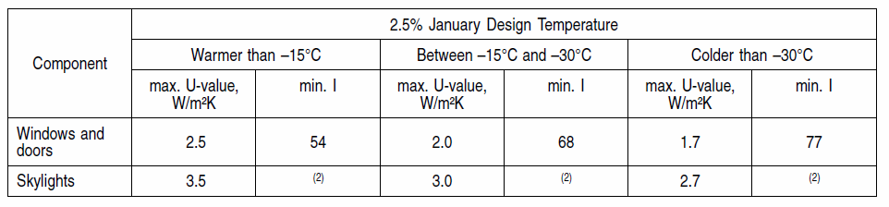
9.7.3. Thermal Characteristics
New approach for basic thermal performance
  In “normal conditions” need to conform to Table 9.7.3.3.
    U-value – Maximum thermal transmittance
    I factor – condensation resistance
      Does not apply to sloped glazing
      Can be tested according to CSA A440.2
  In “high moisture” conditions need to conform to Section 5.3.
Notes:
A new approach was used to require a minimum basic thermal performance
that should reduce the risk of condensation in most cases, although it is recognized that condensation resistance is influenced by many other factors.
Table 9.7.3.3. lists maximum U-values for windows, doors and skylights for three climate zones based on the January design temperature.
The table also lists the less common I-factor, which is an indication for the condensation resistance of a window or door.
All these requirements apply at normal conditions, which means in most residential, office and mercantile occupancies.
Only where the intended use of the building generates a lot of moisture, design to Part 5 would be required.
This terminology is consistent with new requirements in Section 9.25. for vapour barriers.

Slide 21
9.7.4. Manufactured Products
Application
  Windows, doors, and skylights covered in scope
  of harmonized standard
Compliance path
  This Subsection and applicable requirements in Subsection 9.7.6.
  Determine appropriate loads from Canadian supplement for service conditions and geographic location
  Select product meeting required performance grade in NAFS
Minimum level of performance is performance class R
Exterior wood flush doors shall conform to CSA O132.2
Notes:
This Subsection deals with fenestration products that are covered in the scope of the harmonized standard.
The subsection sets out the compliance procedures as described before
Use Canadian Supplement to identify loads
Use Harmonized standard to select minimum acceptable Performance Grade
Comply with remainder of this Subsection, and applicable requirements in Subsection 9.7.6.
When selecting a performance grade only look at “R” class.
Exterior wooden doors also have to comply with CSA O132.2 standard, which is an existing requirement that was moved here.

Slide 22
9.7.5. Site-Built Products
Application
  Windows, doors, and skylights not covered in scope
  of AAMA/WDMA/CSA 101/I.S. 2/A440 NAFS
  North American Fenestration Standard/Specification
  for Windows, Doors and Skylights
Compliance path
  Subsections 9.7.5. and 9.7.6., or
  Subsections 9.7.4. and 9.7.6, or
  Design to Part 5
Glass for site-built products shall comply with Section 9.6
Notes:
Subsection 9.7.5. deals with fenestrations products not covered in the scope of the harmonized standard.
In other words the requirements in this Subsection apply to site-built fenestration components.
In reality it will most likely apply to site-built doors as site-built windows and skylights are very rare.
The compliance path for these site-built products could be
- to simply follow this Subsection and Subsection 9.7.6., Installation,
- or – if a builder wanted to – to have his product tested according to the harmonized standards i.e. Subsection 9.7.4. and then to follow installation requirements in 9.7.6, or
one could design and construct a site-built product according to Part 5.
Keep in mind that the performance requirements are stated in the Section before and that they apply to all fenestration products.
Glass for site-built products shall comply with Section 9.6.

Slide 23
9.7.5. Resistance to Forced Entry
Resistance to forced entry for doors (existing requirements)
  Applies to swinging doors
    Entrance to dwelling units
    Between dwelling units and attached garages
    Access from a storage garage to a dwelling unit
  Types of doors, hardware, deadbolts etc.
Resistance to forced entry for windows
  Windows within 2 m from the ground
  Shall conform to Clause 5.3.5 NAFS
    References ASTM F 588 for primary window (without screens)
    Requires minimum Grade 10 restraint
Notes:
Knowing that site-built products have to comply with the performance requirements – the only performance requirements for which there are deemed-to-comply prescriptive requirements are those on resistance to forced entry.
That’s what you will find in Subsection 9.7.5.
The requirements in 9.7.5.2. apply to swinging doors, entrance to dwelling units and between dwelling units and garages.
The requirements specify the types of acceptable doors, hardware, and location of deadbolts.
Article 9.7.5.3 deals with Resistance to forced entry for windows in dwelling that are 2 m above ground.
The requirement actually refers back to one clause of the harmonized standard for a simple test against forced entry
- The test method references ASTM F 588 and applies only the designated primary window without screens. The standard tests various types to restrain, delay, or frustrate forced entry and addresses a number of different window types. The harmonized standard requires a minimum of Grade 10 restraint.
There are no requirements for forced entry resistance for skylights.

Slide 24
9.7.6. Installation
All fenestration products have to conform with CSA A440.4
  Plywood shims can be used
  Follow 9.27. for proper detailing of
    flashing and
    wall-window junctions
Manufactured, pre-assembled and field-assembled products shall conform to manufacturer’s instructions
(i.e. not site-built)
Seal fenestration products to air barriers and vapour barriers
Notes:
Subsection 9.7.6. contains requirements for the installation of all fenestration products.
The Subsection references a new CSA installation standard for windows doors and skylights in low rise buildings.
- Both – manufactured and site-built products have to conform to this standard
- In addition, the code allows the use of plywood shims and points to further requirements for the rough opening and the wall-window interface in 9.27, such as flashing.
Manufactured products also have to comply with manufacturer’s instructions.
This does not apply to site-built products since there isn’t a manufacturer.
There is a specific provision in this Section requiring that fenestration products are sealed to air and vapour barriers.
This is simply a clarification provided here of a requirement already in Section 9.25. on air barriers.

Slide 25
9.7.6. Sealants, Trim and Flashing
All existing requirements
Now apply to all windows, doors and skylights
  Compatibility of sealant materials required
  Construct flashing according to 9.27.
  Apply sealants between windows and cladding according to 9.27.
  Protect aluminum parts in contact with edges of masonry, concrete, stucco or plaster with alkali-resistant coating
Notes:
Article 9.7.6.2. contains mostly existing requirements from the masonry section – now applied to all windows, doors and skylights - about sealants, trim and flashing.
The provisions require
- Compatibility of sealant materials with adjacent materials
- Construct of flashing according to 9.27.
- To apply sealants between windows and cladding according to 9.27.
- And have a special provision to address the protection of aluminum parts from the adverse effects of masonry, concrete, stucco or plaster.

Slide 26
9.27.4. and 5.10. Sealants
No testing and certification available
Liability for industry
Deletion of out-dated CGSB standards
  CGSB 9-GP-5M “Sealing Compound, One Component, Acrylic Base, Solvent Curing”
  CAN/CGSB-19.13-M “Sealing Compound, One-Component, Elastomeric, Chemical Curing”
  CGSB 19-GP-14M “Sealing Compound, One Component, Butyl-Polyisobutylene Polymer Base, Solvent Curing”
  CAN/CGSB-19.24-M “Multicomponent, Chemical-Curing Sealing Compound”
Ensuring equivalent performance
Notes:
There are additional changes to sealants.
They don’t just apply to windows, doors and skylights but to all sealants used for cladding or other building envelope applications.
A number of outdated CGSB sealant and caulking standards were replaced because there was no testing and certification available for these products, which left the industry with an increased liability of not being able to comply with code.

Slide 27
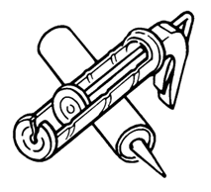
9.27.4. and 5.10. Sealants
Addition of ASTM standards
  ASTM C 834 “Latex Sealing Compounds”
  ASTM C 920 “Elastomeric Joint Sealants”
  ASTM C 1184 “Structural Silicone Sealants”
  ASTM C 1311 “Solvent Release Sealants”
  ASTM C 1330 “Cylindrical Sealant Backing for Use with Cold Liquid Applied Sealants”
Referencing up-to-date standards for sealant products
Relevant and new sealant product categories
A standard for backer rods
Notes:
Here you can see the new list of standards.
These standards are more up-to-date and deal with products used in the market today [read from list]
ASTM C 834 “Latex Sealing Compounds”
ASTM C 920 “Elastomeric Joint Sealants”
ASTM C 1184 “Structural Silicone Sealants”
ASTM C 1311 “Solvent Release Sealants”
ASTM C 1330 “Cylindrical Sealant Backing for Use with Cold Liquid Applied Sealants”
The standards are listed in subsection 9.27.4. and Table 5.10.1.1.
A standard for backer rods was also added since this was previously not addressed, but has become accepted practice at least in some cases.
Subsection 9.27.4. doesn’t require the use of backer rods but lists a standard for compliance where they are used.

Slide 28
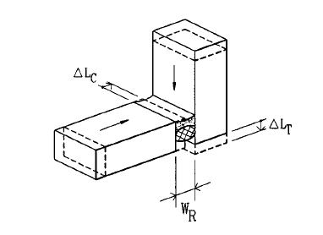
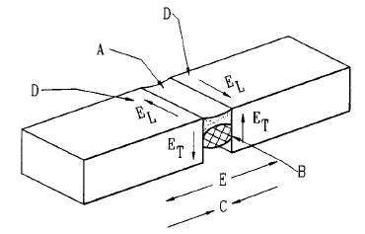
9.27.4. and 5.10. Sealants
Addition of Appendix Notes
  Reference guides
    ASTM C 1193 Use of Joint Sealants
    ASTM C 1299 Selection of Liquid-Applied
    Sealants
    ASTM C 1472 Calculating Movement and Other
    Effects When Establishing Sealant Joint Width
  Provide guidance on
    joint preparation
    sealants installation
    application of sealants in unprotected environments
  Emphasize importance of manufacturers’ literature
  on materials and procedures
Notes:
In addition to the new material standards that I just described, the Appendix Notes to Subsection 9.27.4. and Table 5.10.1.1. offer additional information for
use of joint sealants and proper selection of sealants (especially when looking at service conditions and temperatures)
But also guidance for calculating movement and other
effects when establishing sealant joint width
The guides contain information on
Joint preparation
Sealants installation
Application of sealants in unprotected environments
The Appendix Notes also emphasize the importance of consulting up-to-date manufacturers’ literature on materials and procedures.

Slide 29
www.nationalcodes.ca
Questions?
Send them to us at codes@nrc-cnrc.gc.ca
Thank you!
Notes:
This concludes the presentation on windows, doors and skylights and sealants for Part 5 and Part 9.
Thank you for your attention.
If you have questions, please send them to codes@nrc-cnrc.gc.ca

